Slide 1
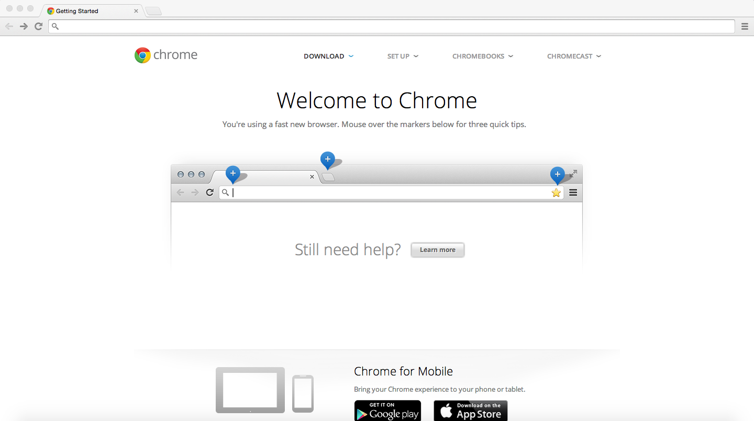


MyDesign

Slide 2
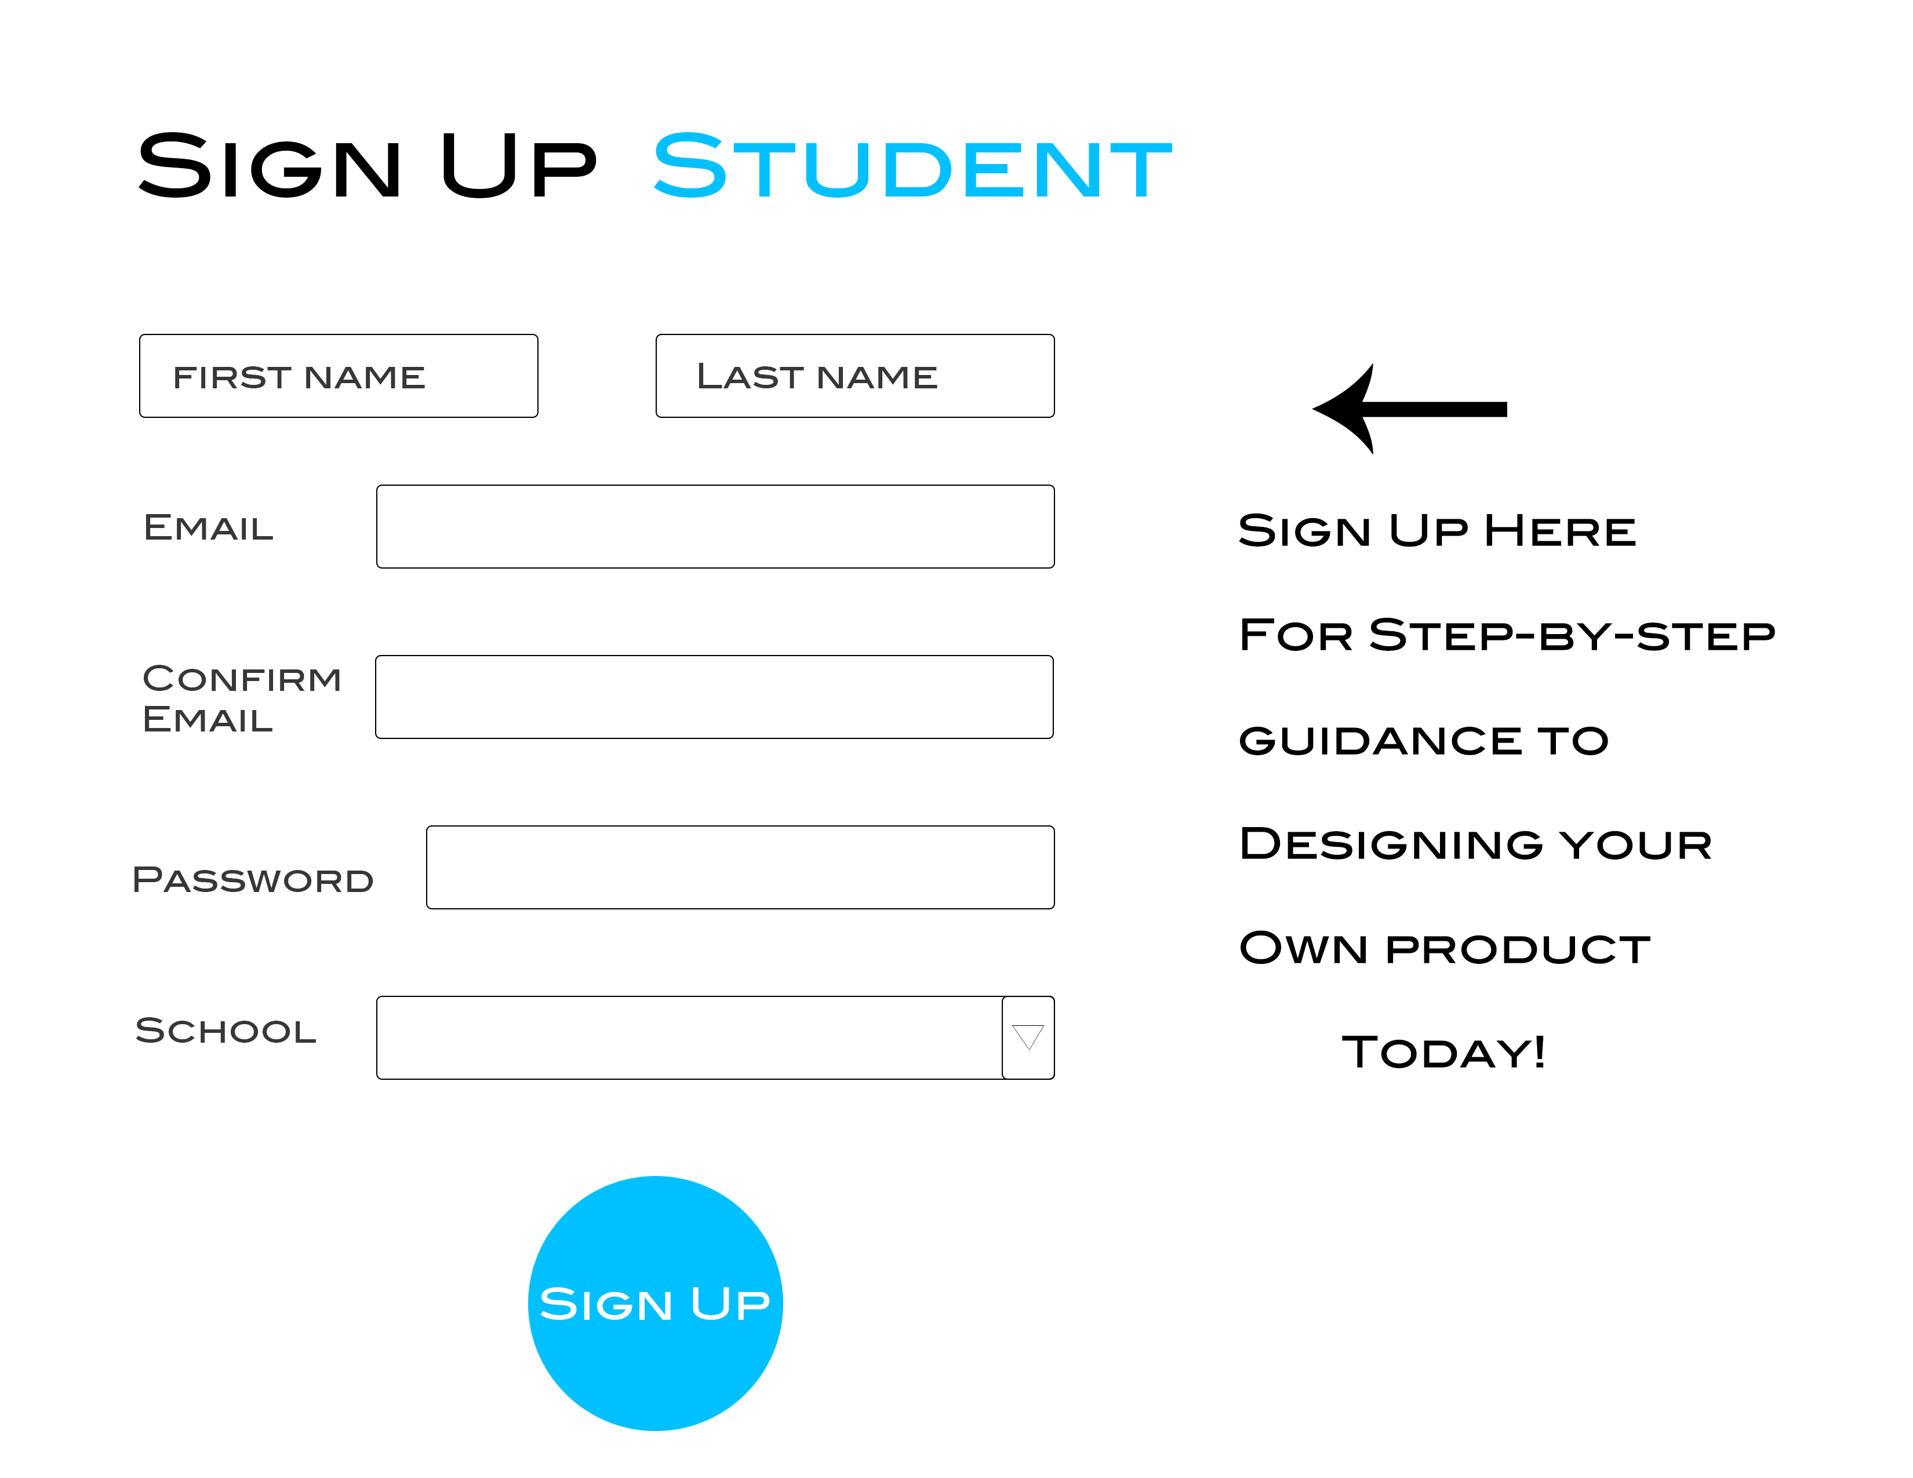
MyDesign
CLICK HERE
TO SIGN UP

Slide 3


MyDesign
CLICK HERE
THEN SIGN IN

Slide 4
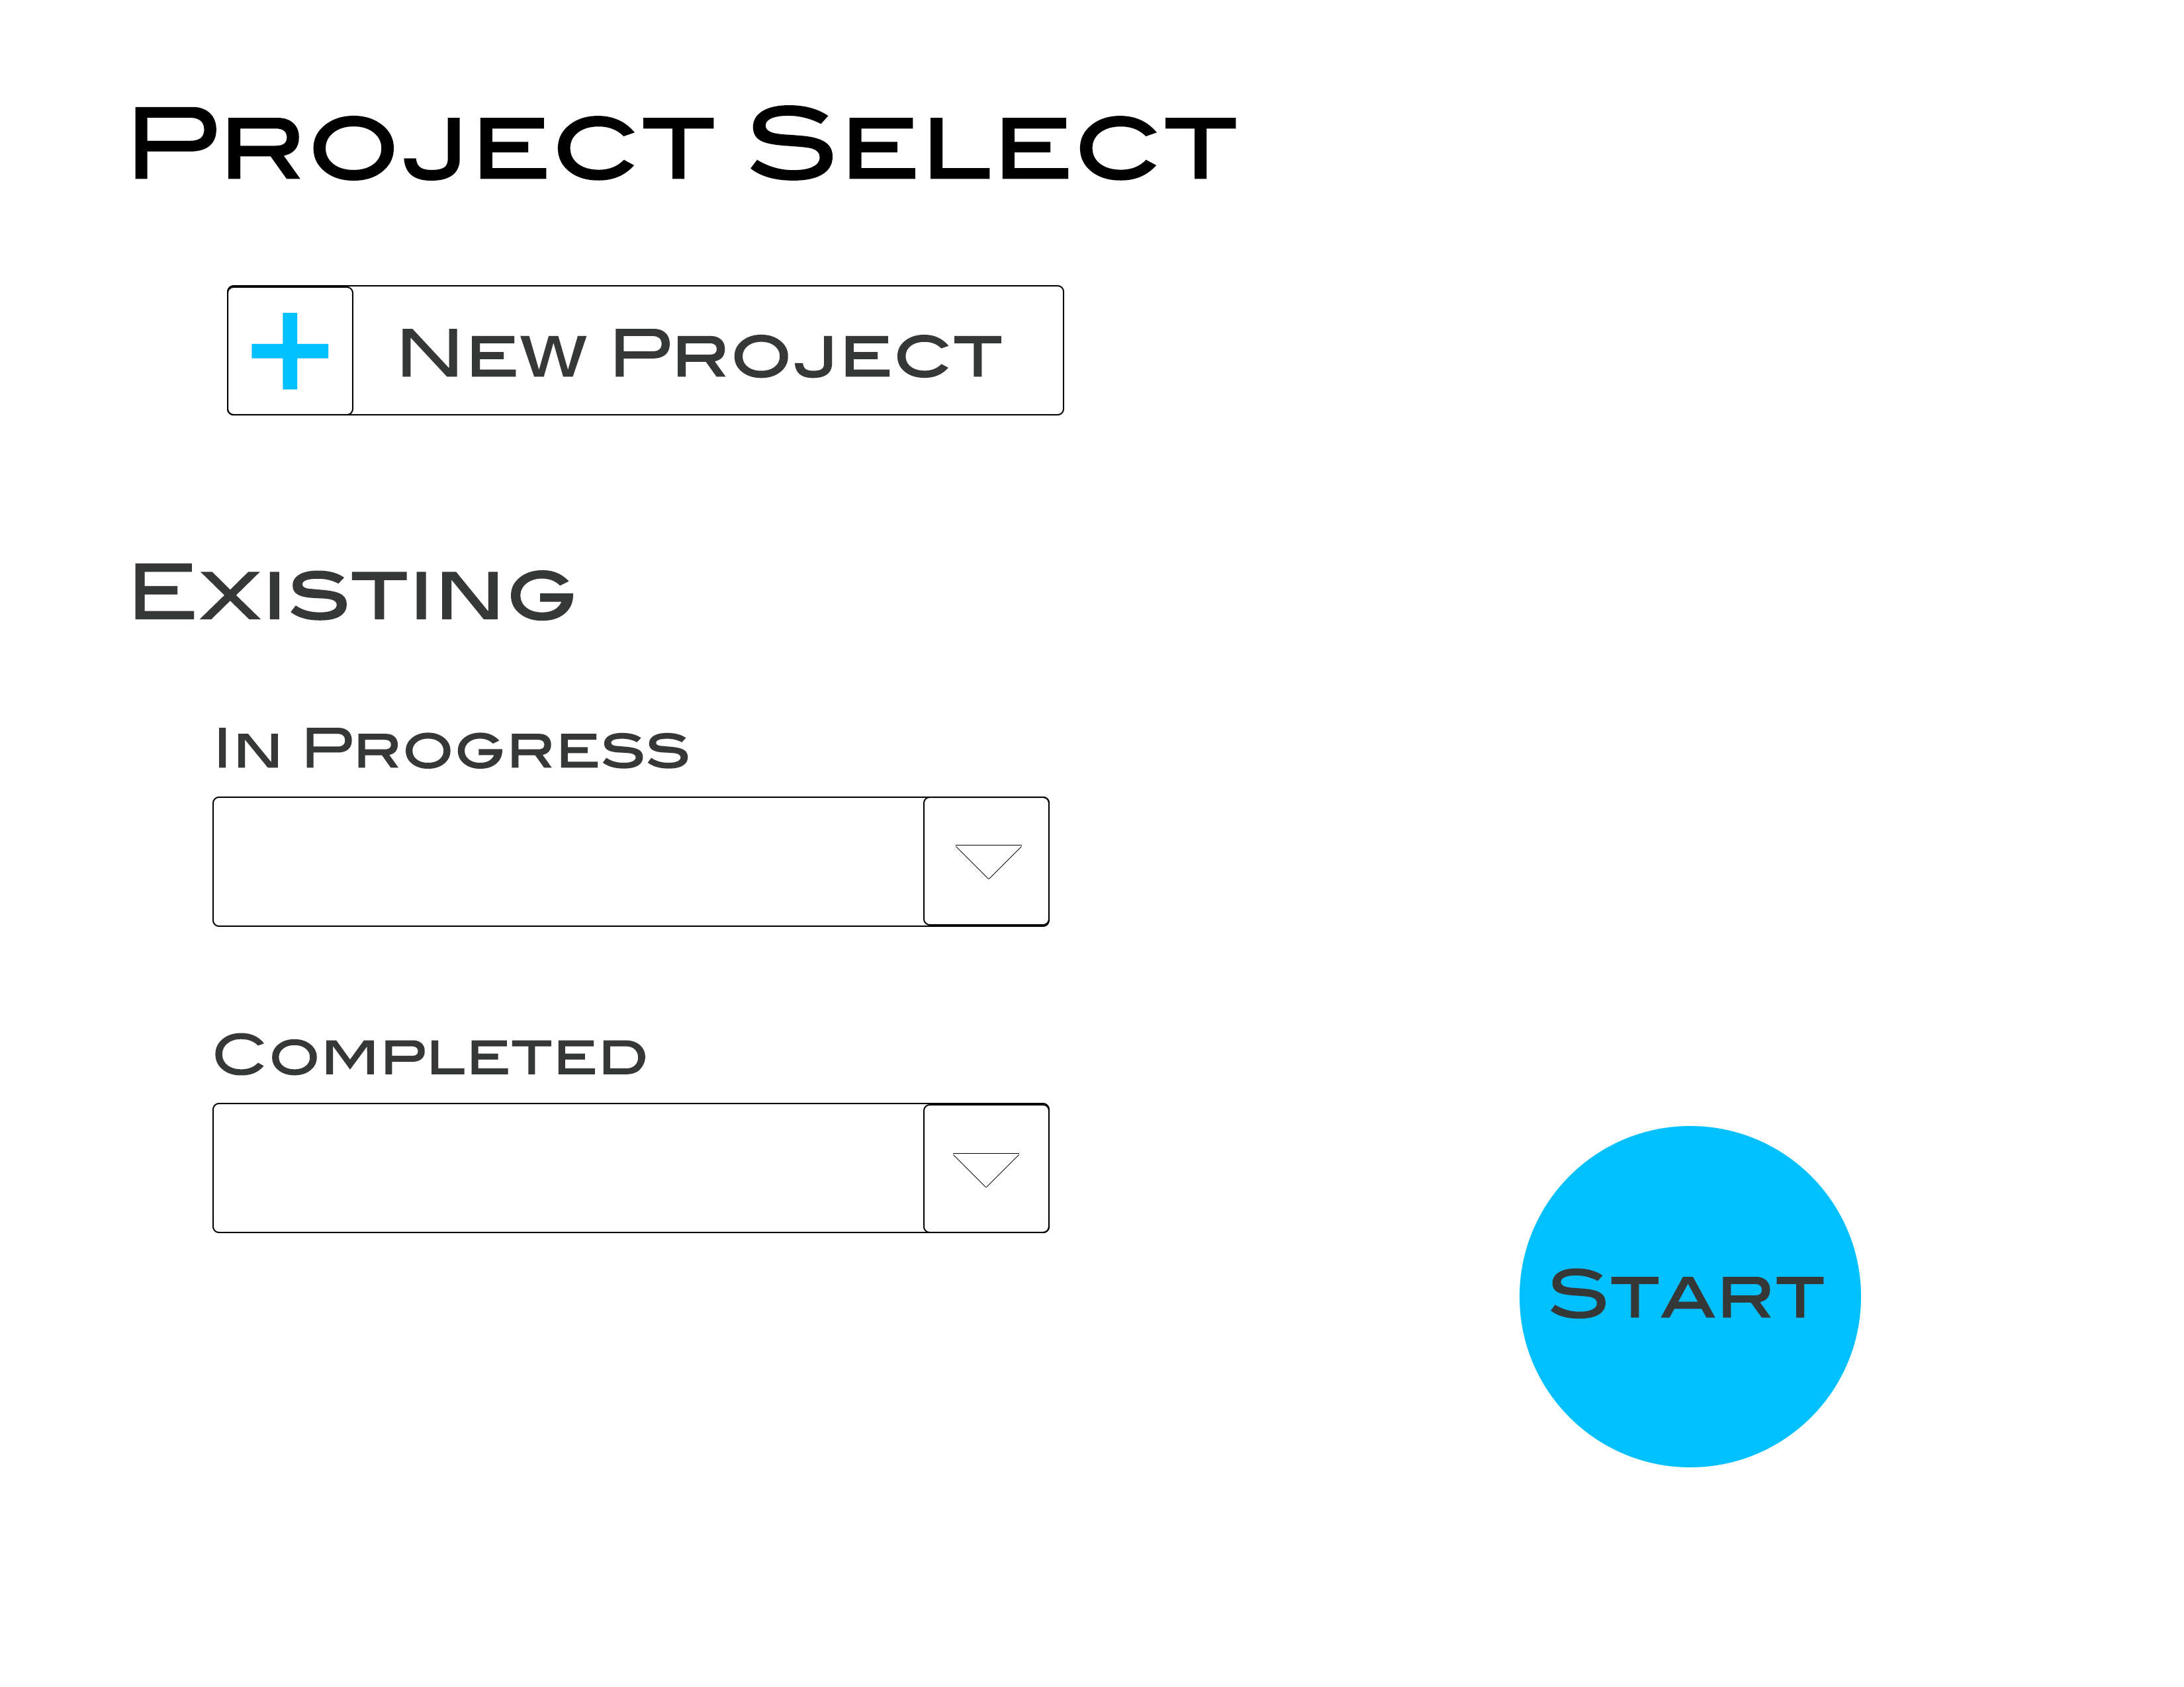
MyDesign
CLICK HERE

Slide 5
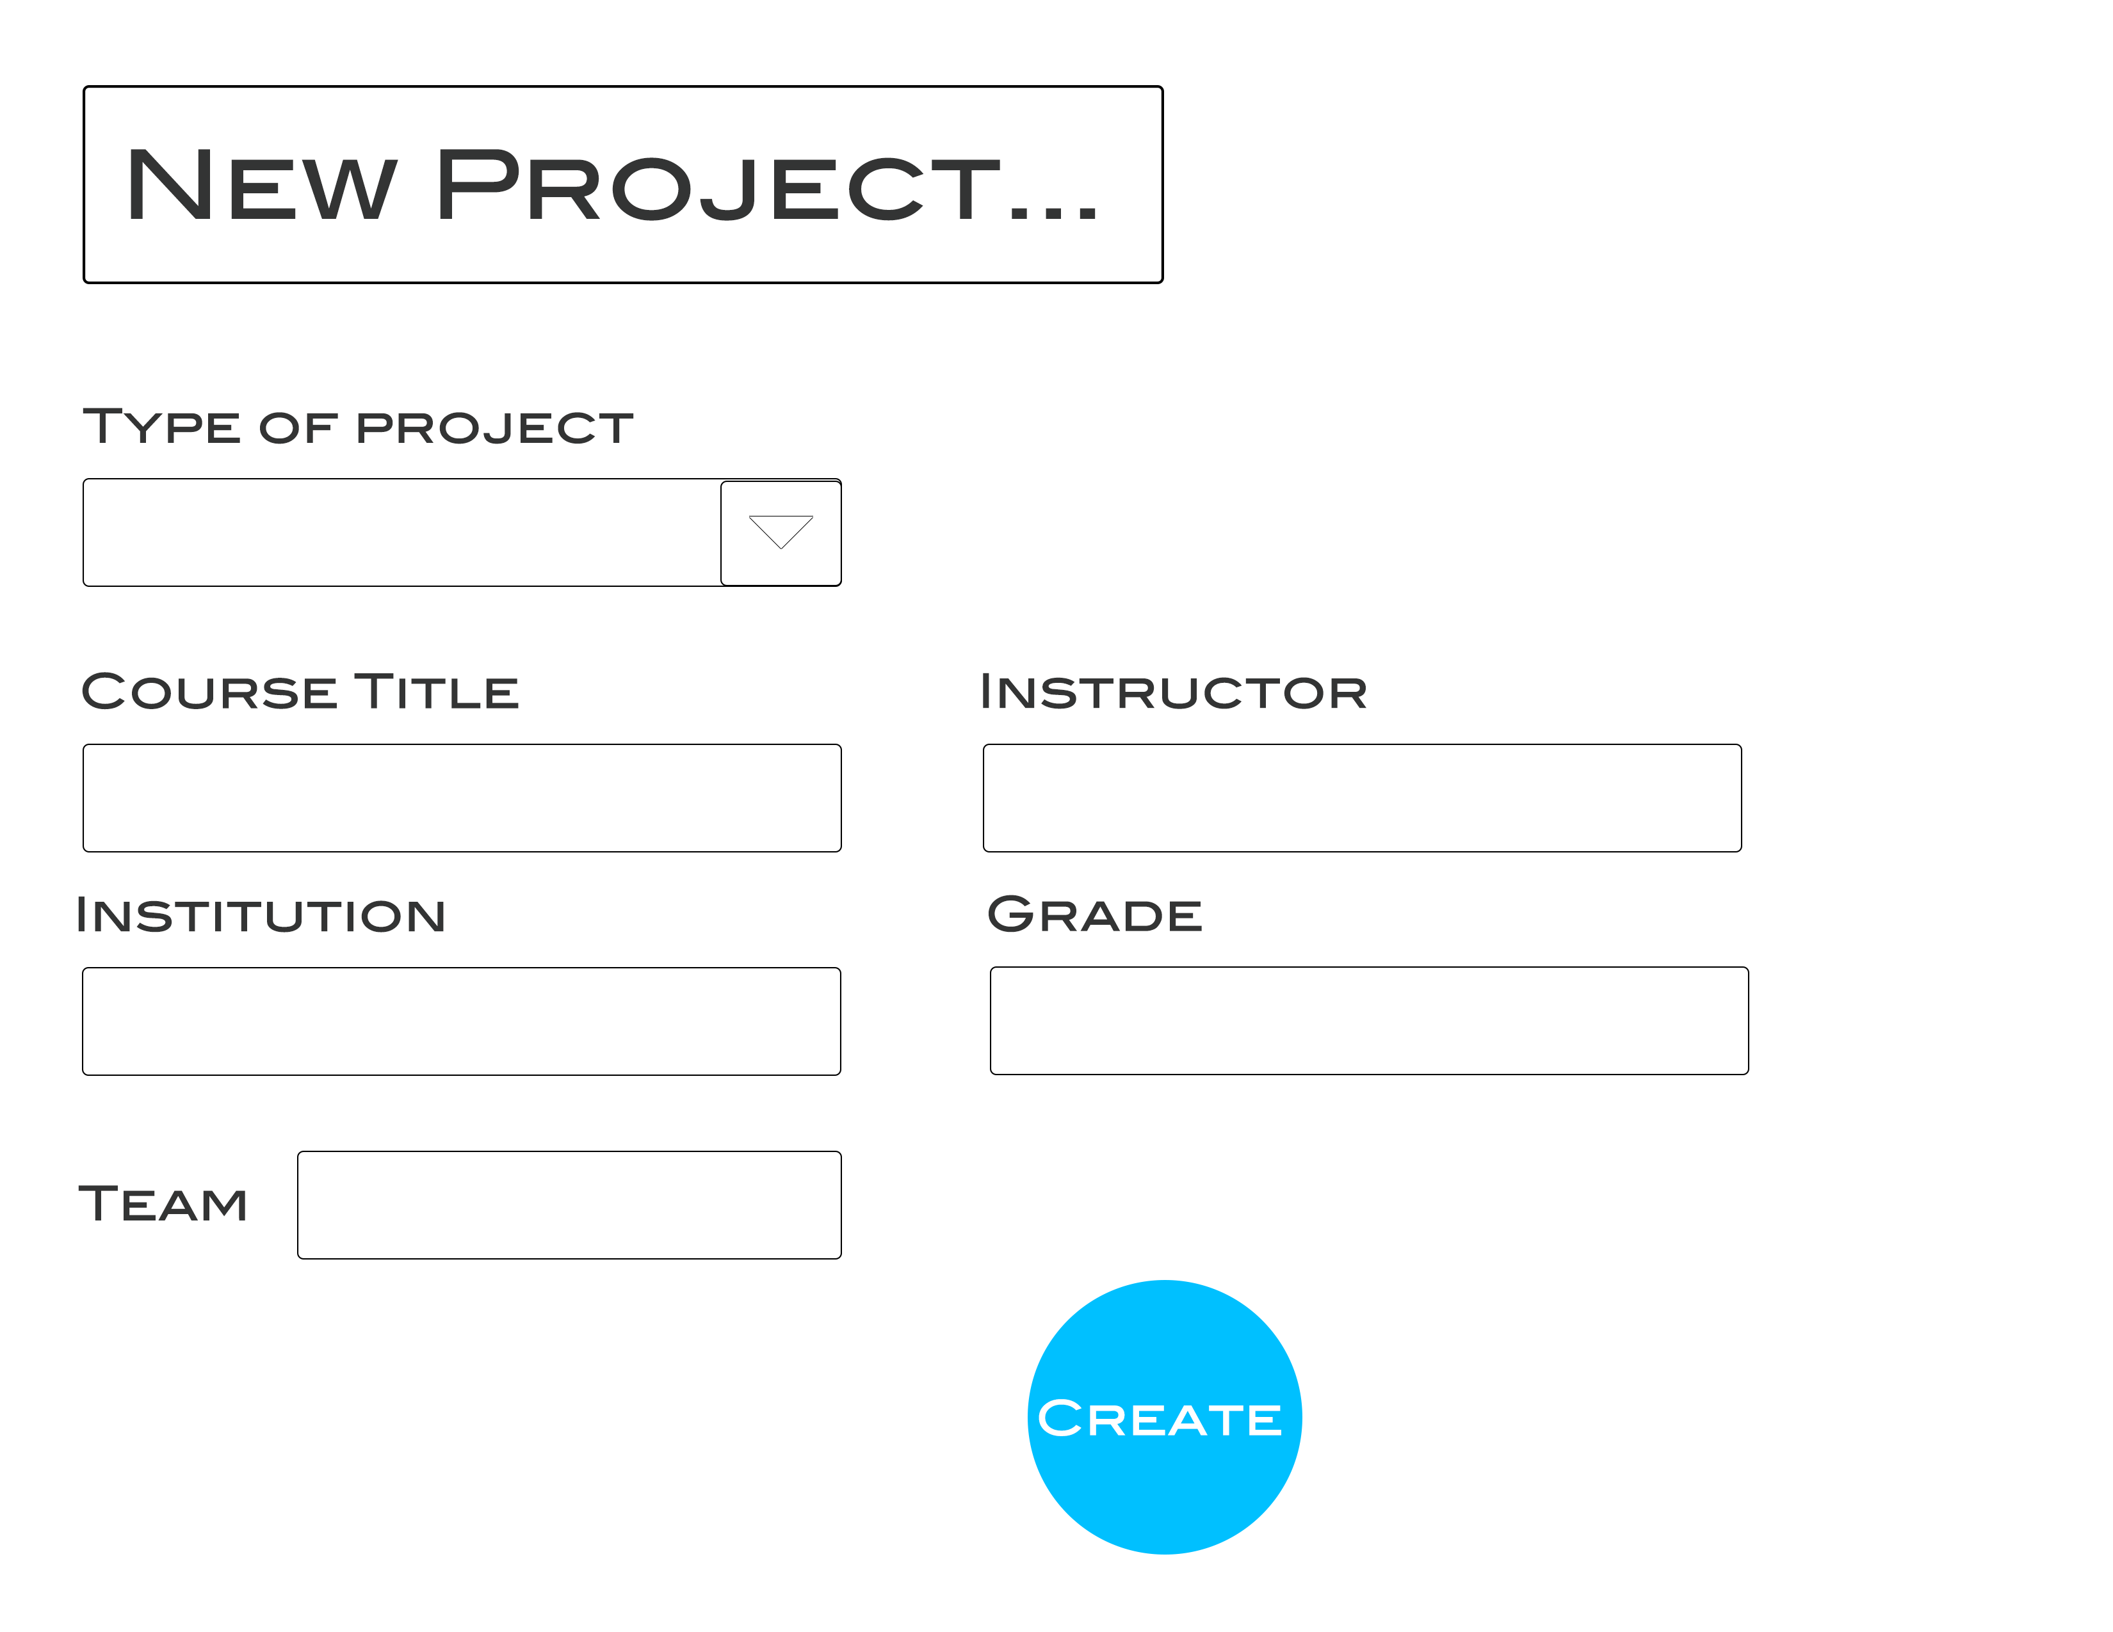
MyDesign
CLICK HERE

Slide 6

MyDesign
New project takes user
to step one of the design
process
Return to Project Select

Slide 7

MyDesign
MyDesign LITE Version
Return to Project Select

Slide 8
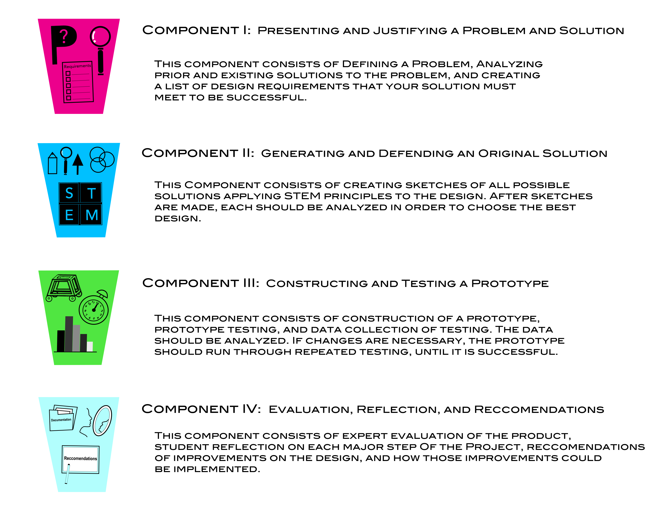

Slide 9
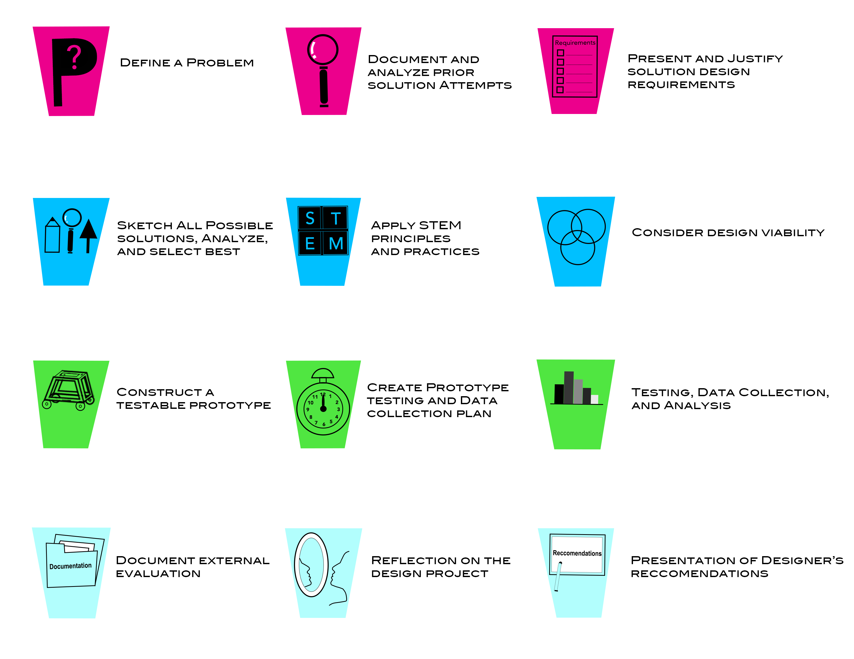

Slide 10
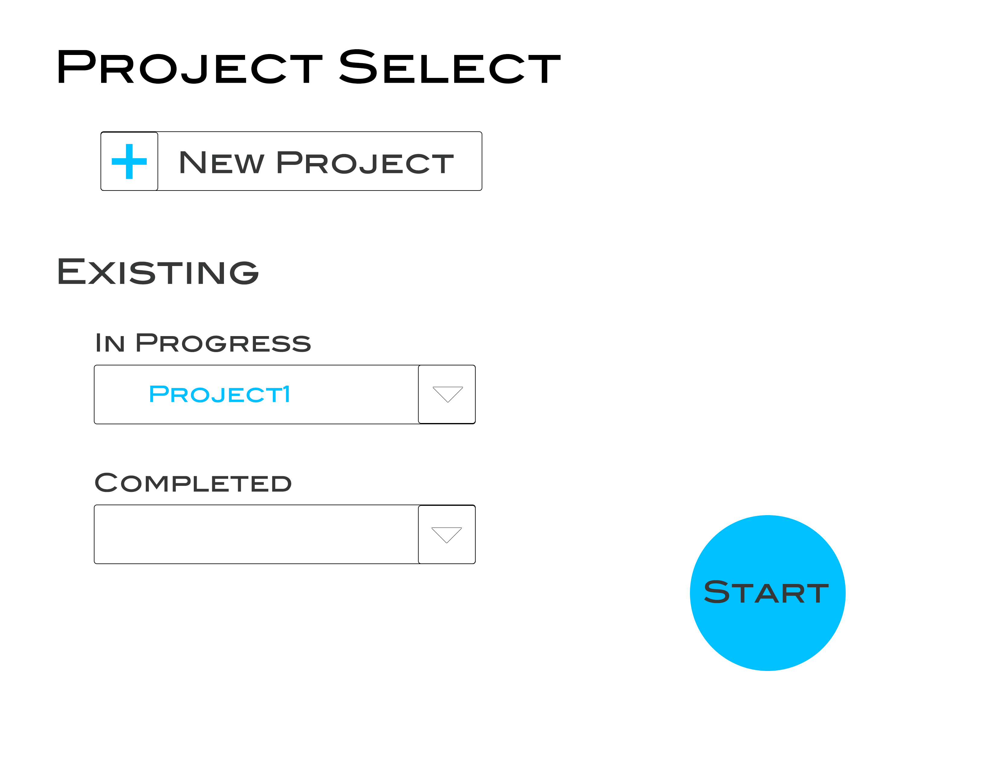
MyDesign
CLICK HERE
Suppose you wanted to choose an existing project?

Slide 11












MyDesign
Highlights the step the user left off of
CLICK HERE

Slide 12

MyDesign
Highlights the step the user left off of
CLICK HERE

Slide 13

MyDesign
Highlights the step the user left off of
CLICK HERE

Slide 14

MyDesign
Highlights the step the user left off of
CLICK HERE

Slide 15

MyDesign
Highlights the step the user left off of
CLICK HERE

Slide 16

MyDesign
Highlights the step the user left off of
CLICK HERE

Slide 17

MyDesign
Highlights the step the user left off of
CLICK HERE

Slide 18

MyDesign
Highlights the step the user left off of
CLICK HERE

Slide 19

MyDesign
Highlights the step the user left off of
CLICK HERE

Slide 20

MyDesign
Highlights the step the user left off of
CLICK HERE

Slide 21

MyDesign
Highlights the step the user left off of
CLICK HERE

Slide 22

MyDesign
Highlights the step the user left off of
CLICK HERE

Slide 23
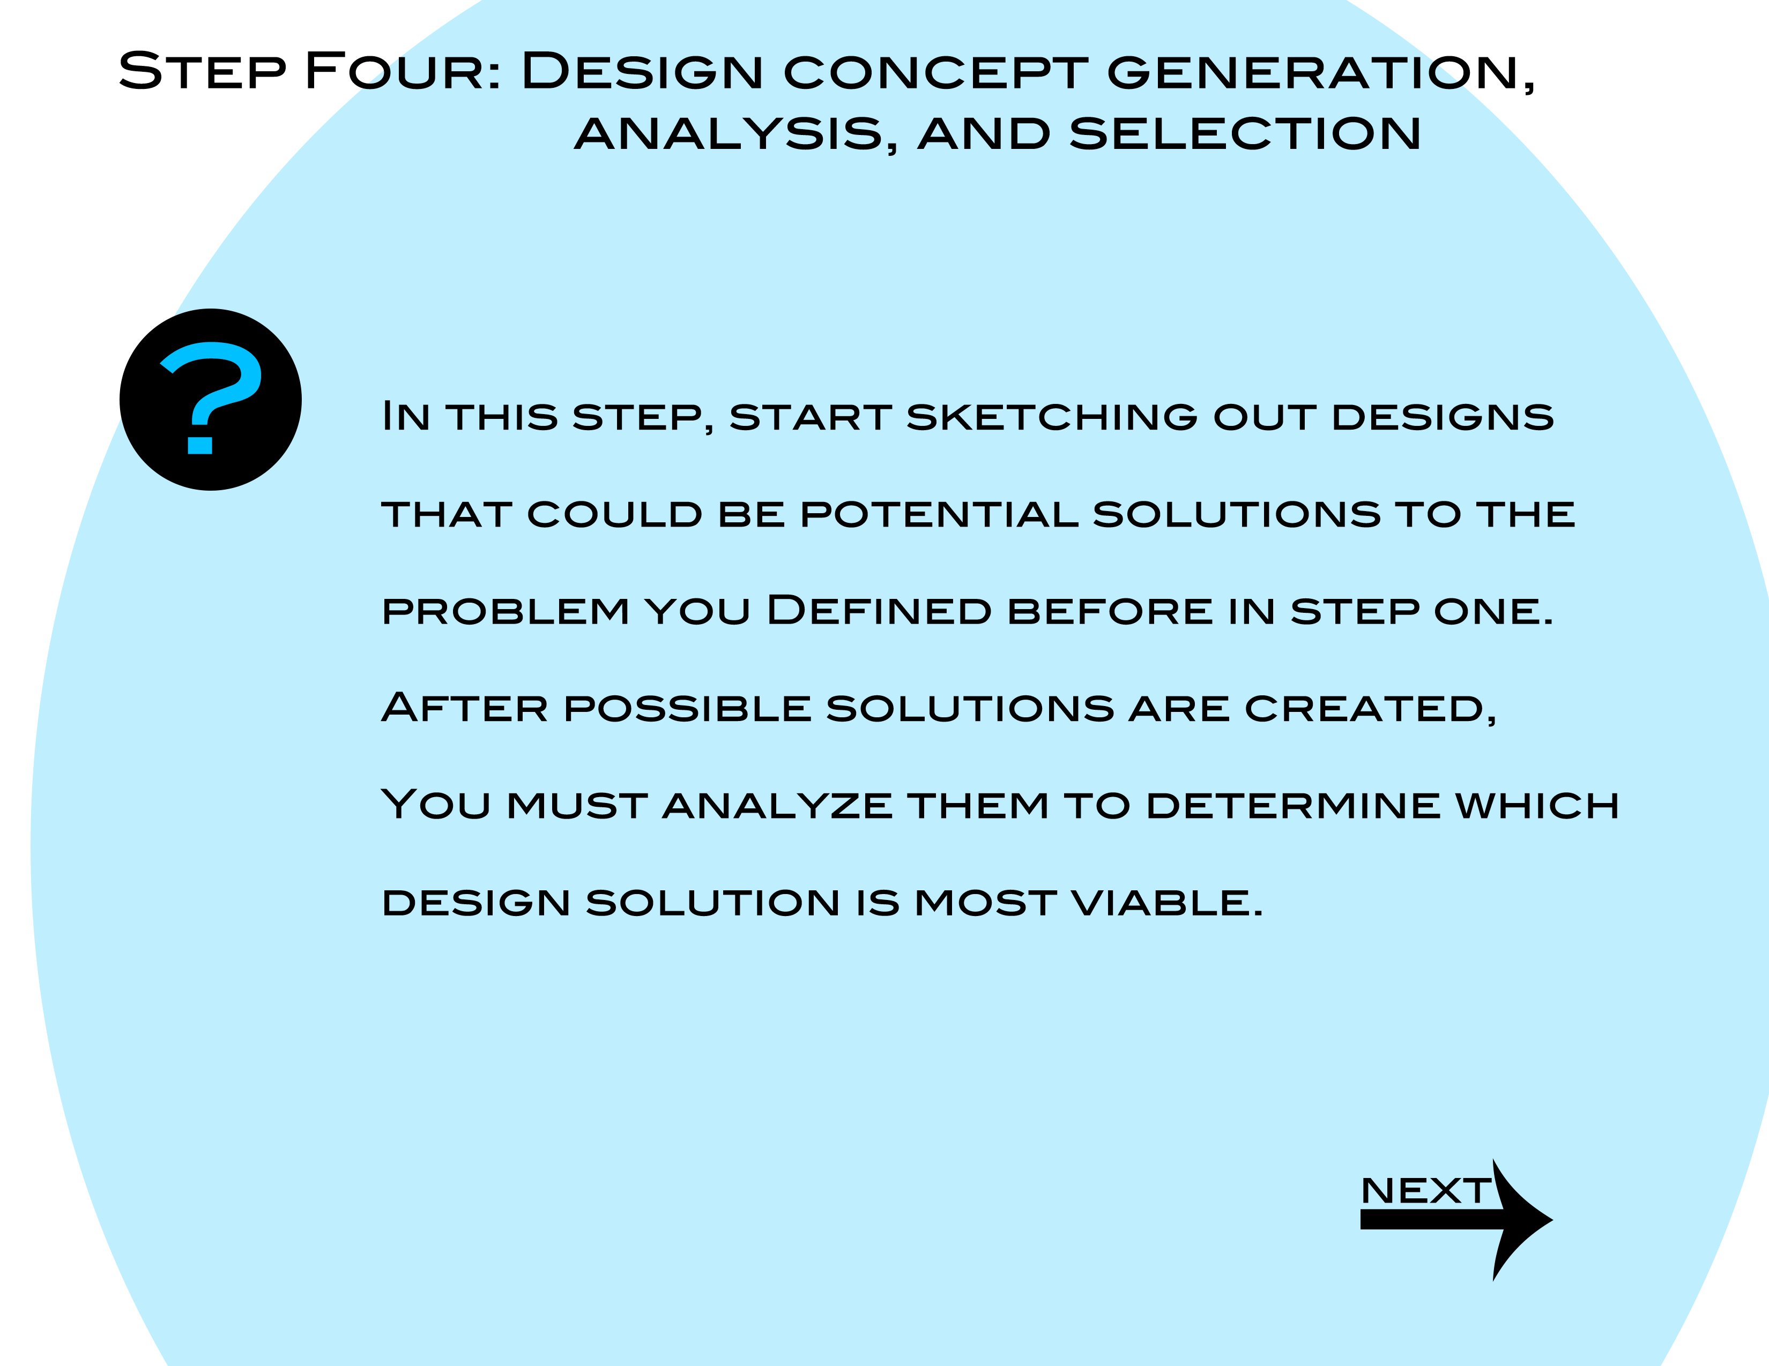
MyDesign
*Summary of step

Slide 24
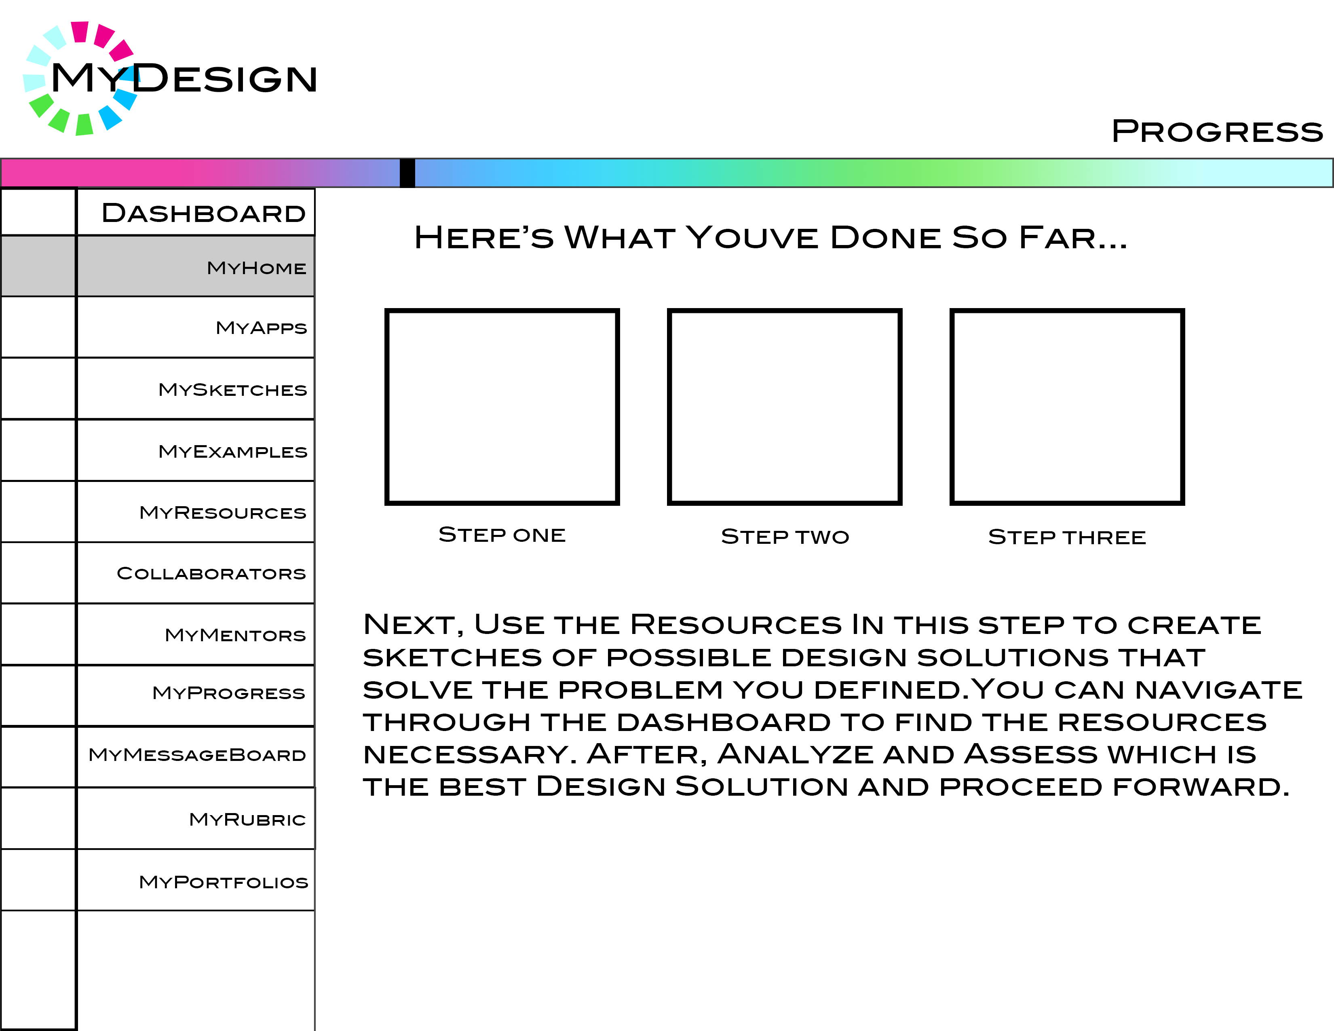
MyDesign
CLICK HERE

Slide 25
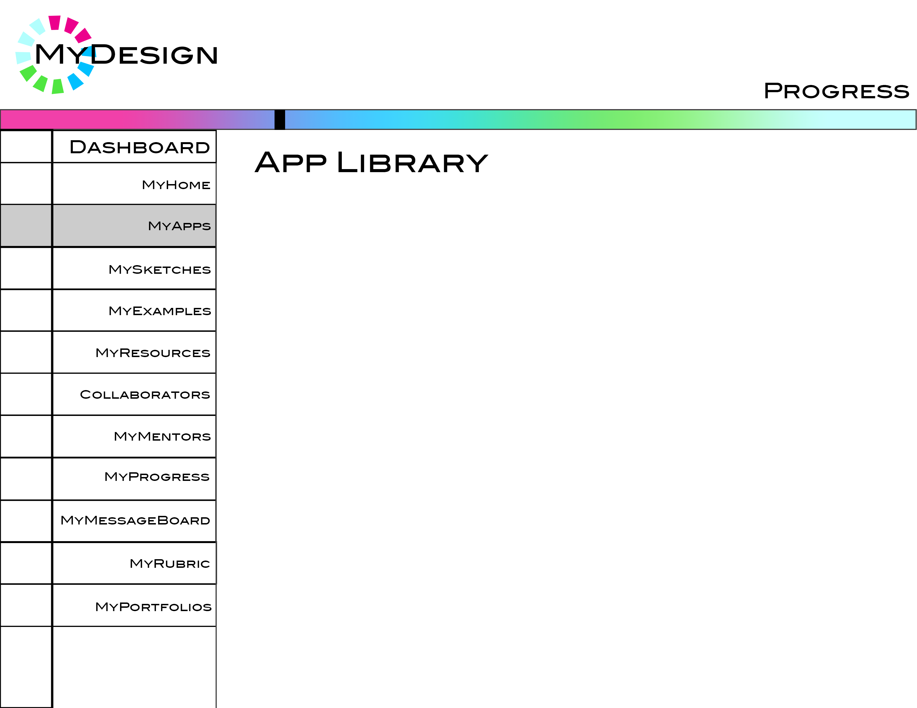
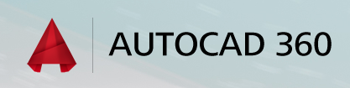
MyDesign
https://client.autocad360.com/createaccount.html
CLICK LINK

Slide 26
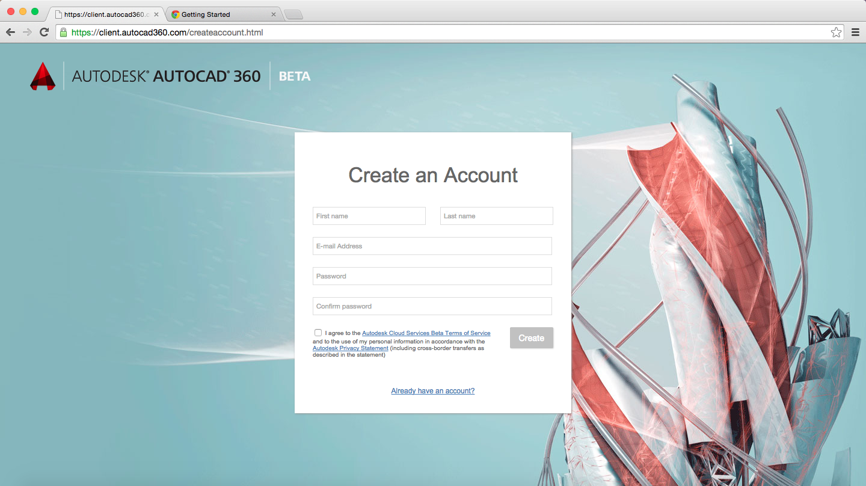
User will sign up for an account with Autodesk AutoCAD 360
MyDesign

Slide 27
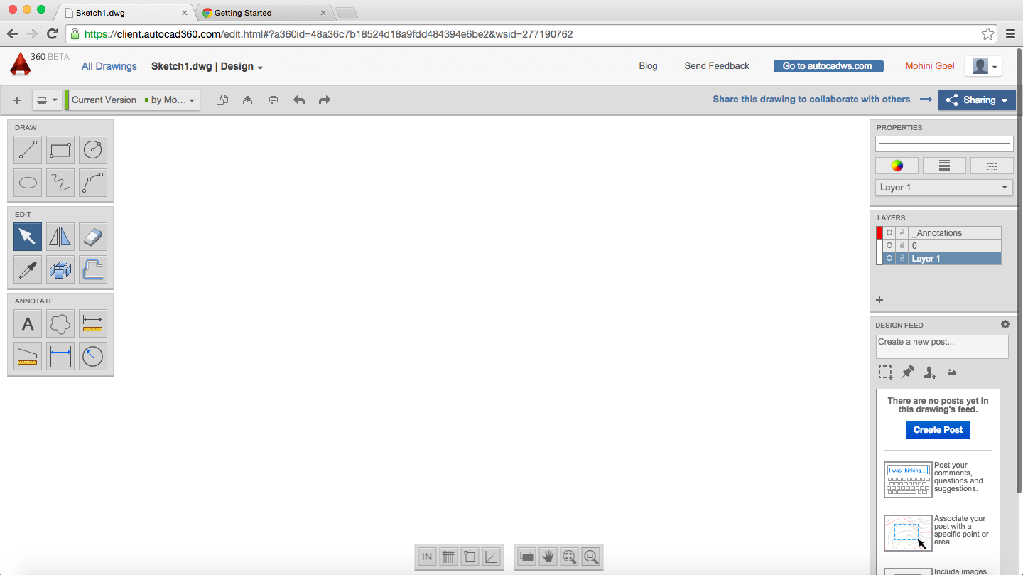
User can create sketches in AutoCAD 360
MyDesign

Slide 28
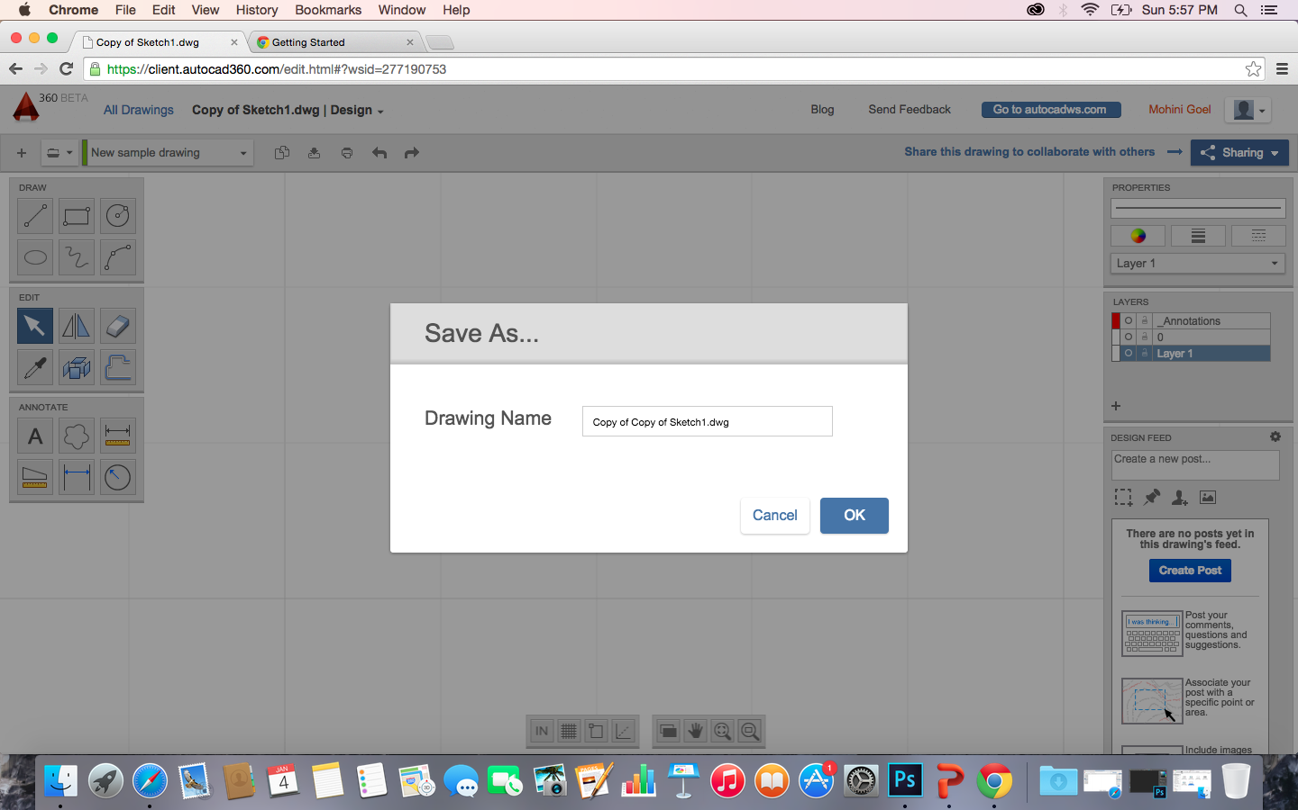
Save them as .dwg files
MyDesign

Slide 29
User can click back to the MyDesign Tab
MyDesign

Slide 30

MyDesign
https://client.autocad360.com/createaccount.html
CLICK HERE

Slide 31
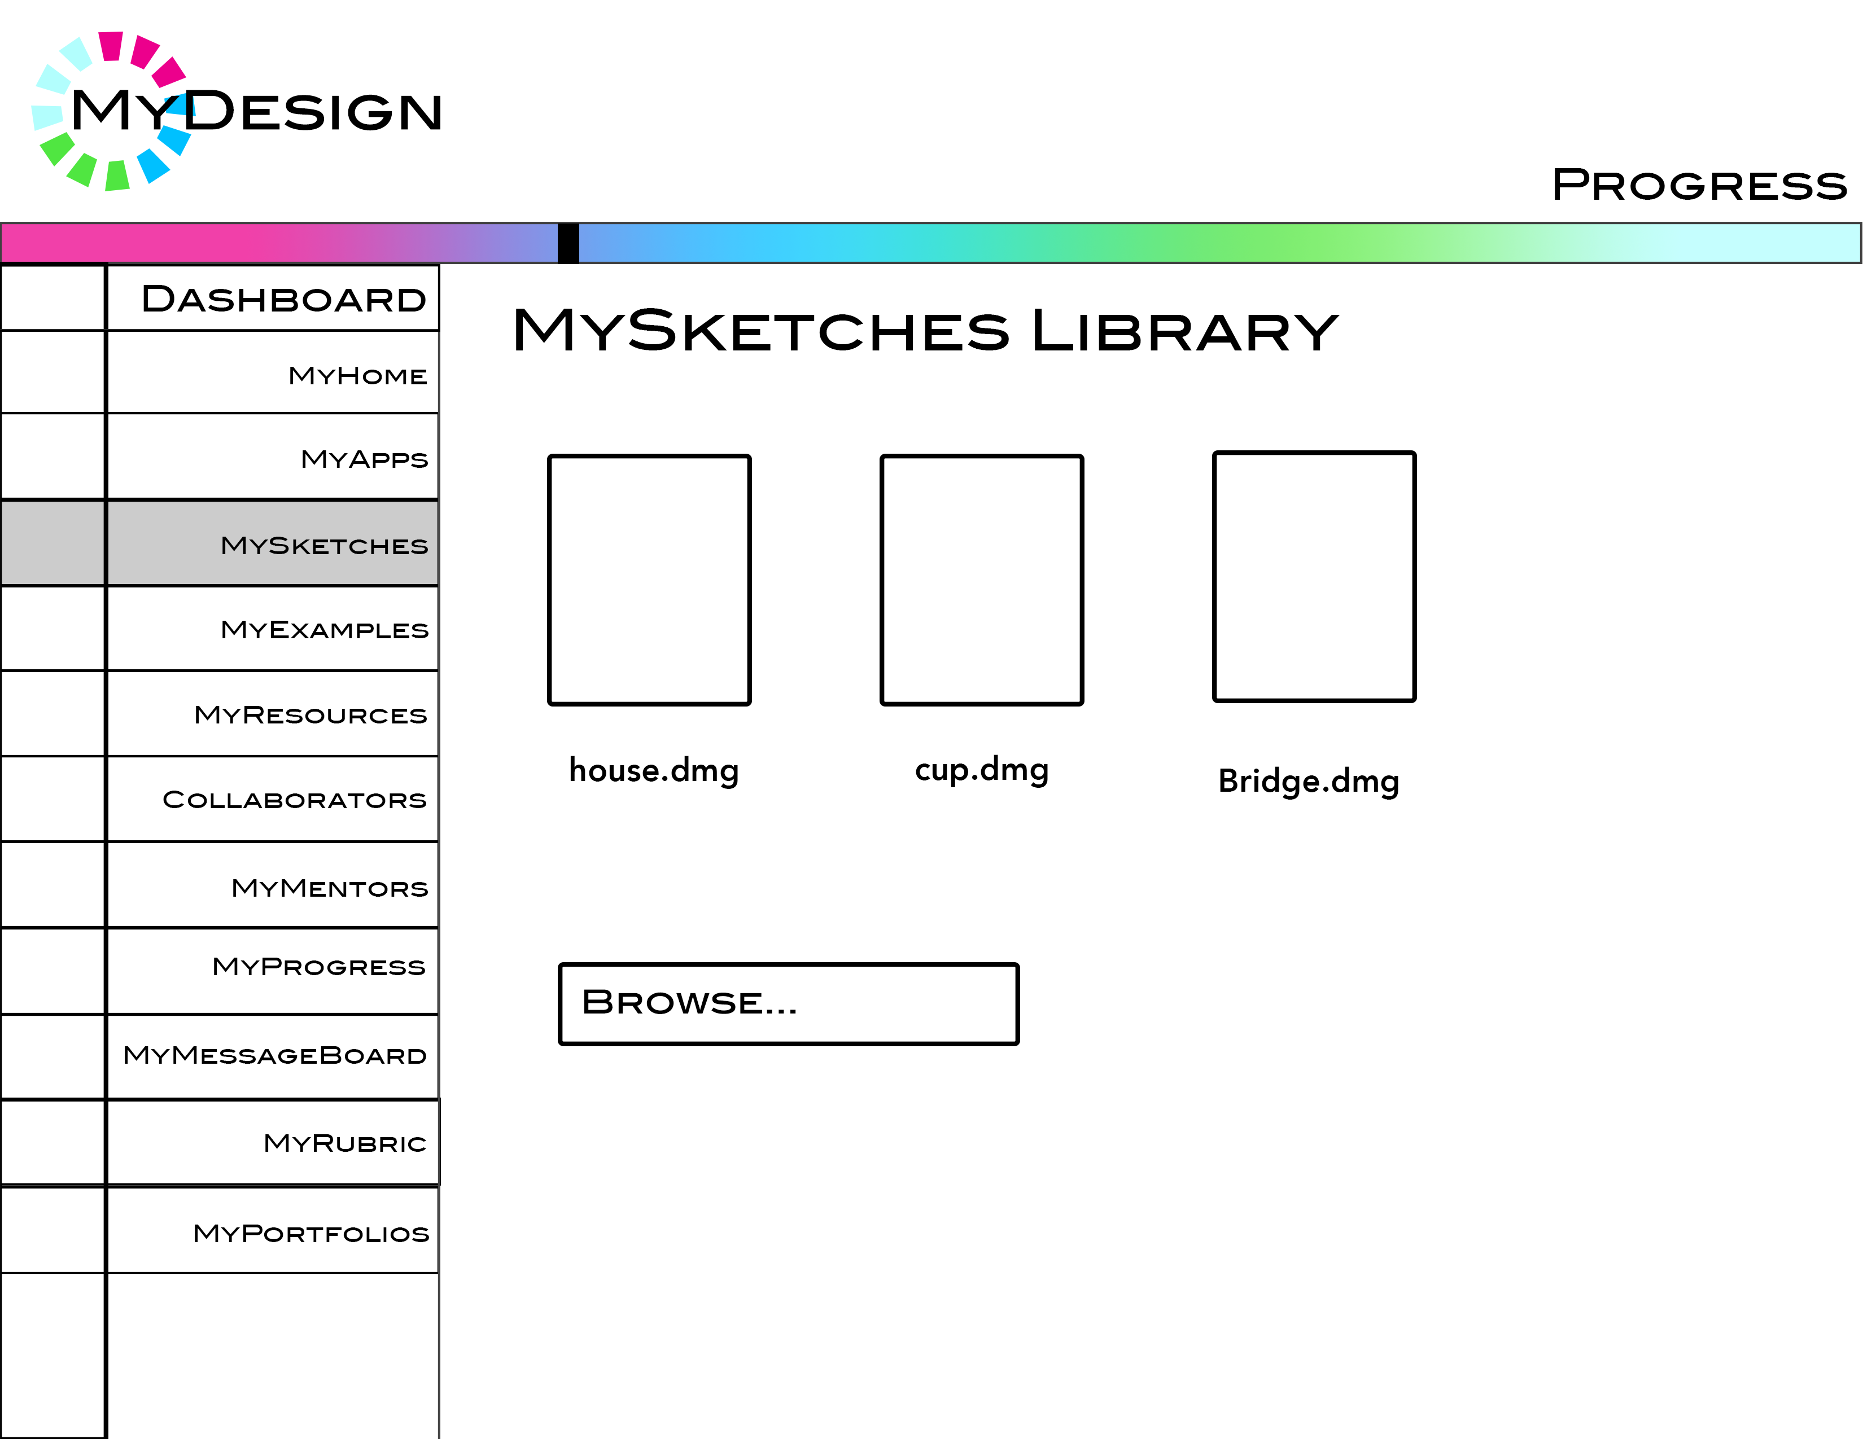
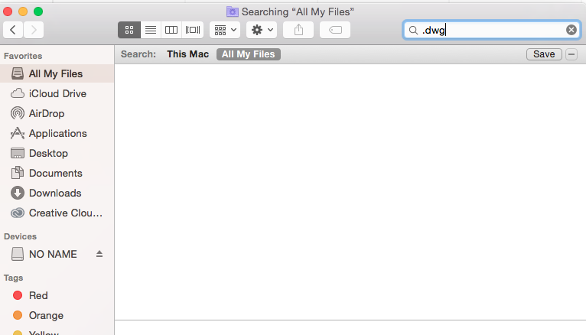
MyDesign
CHOOSE SKETCH FILE
Sketch1.dwg
CLICK BROWSE

Slide 32
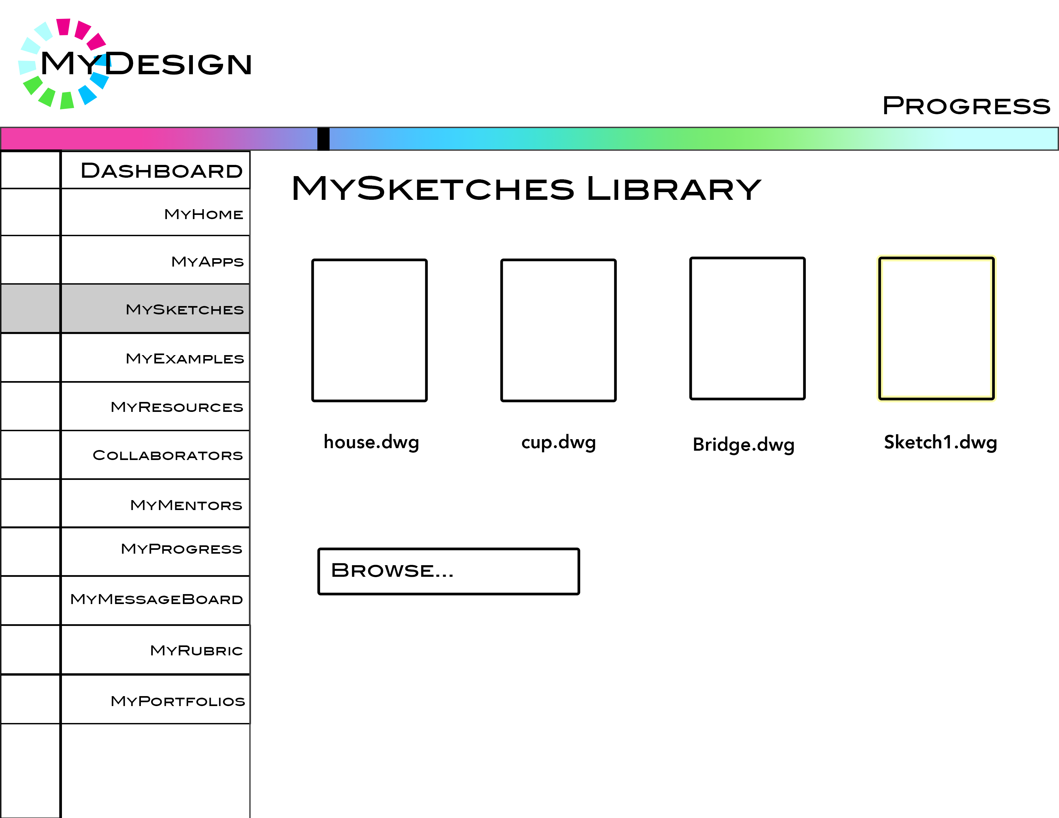
MyDesign

Slide 33
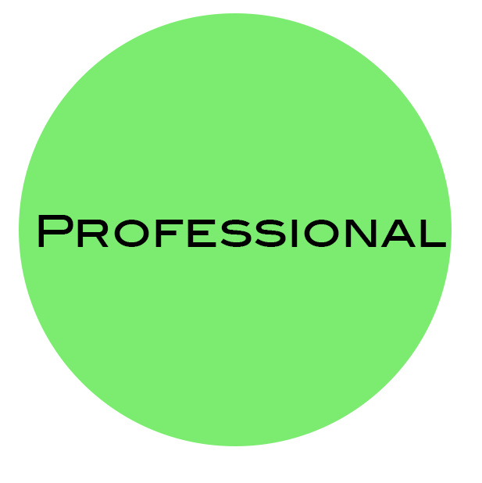
MyDesign

Slide 34
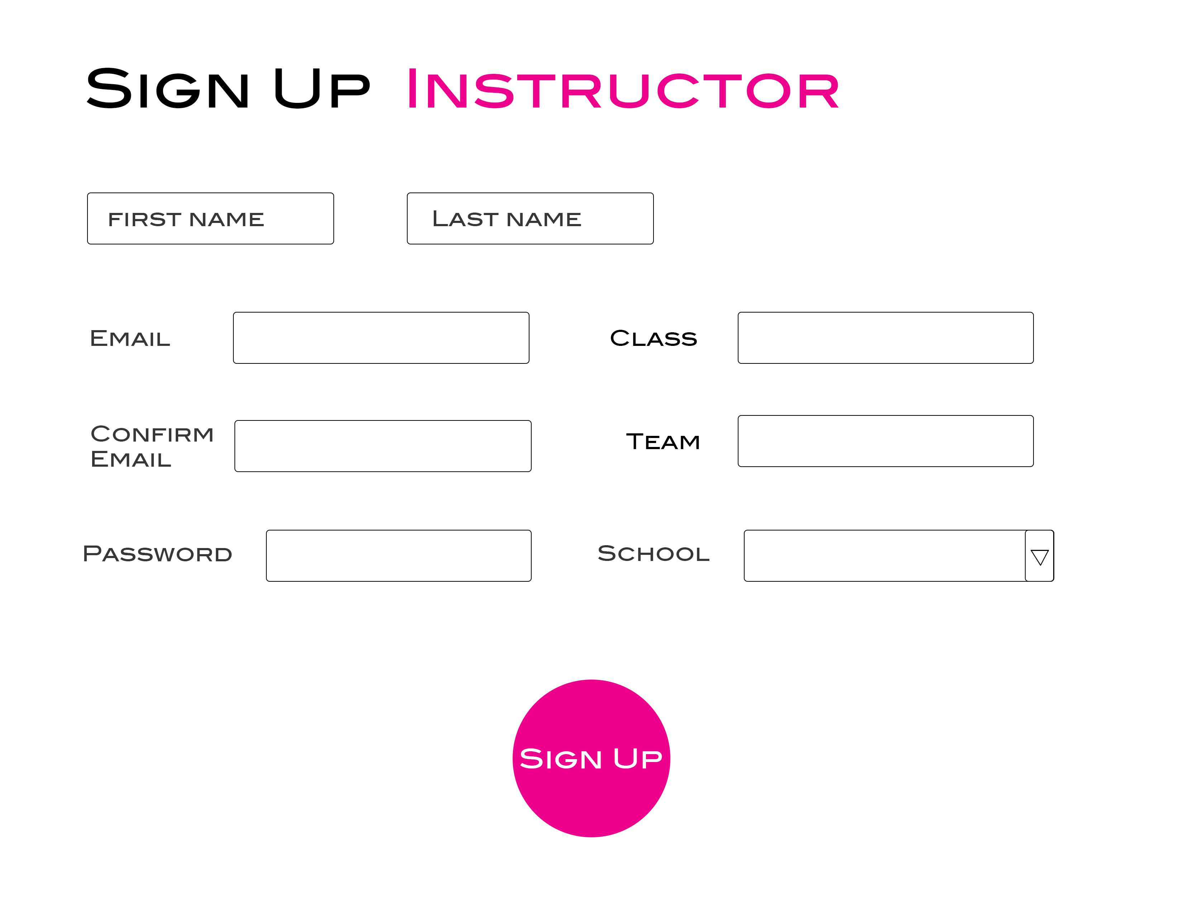
MyDesign
CLICK HERE
TO SIGN UP

Slide 35

MyDesign
CLICK HERE
THEN SIGN IN

Slide 36
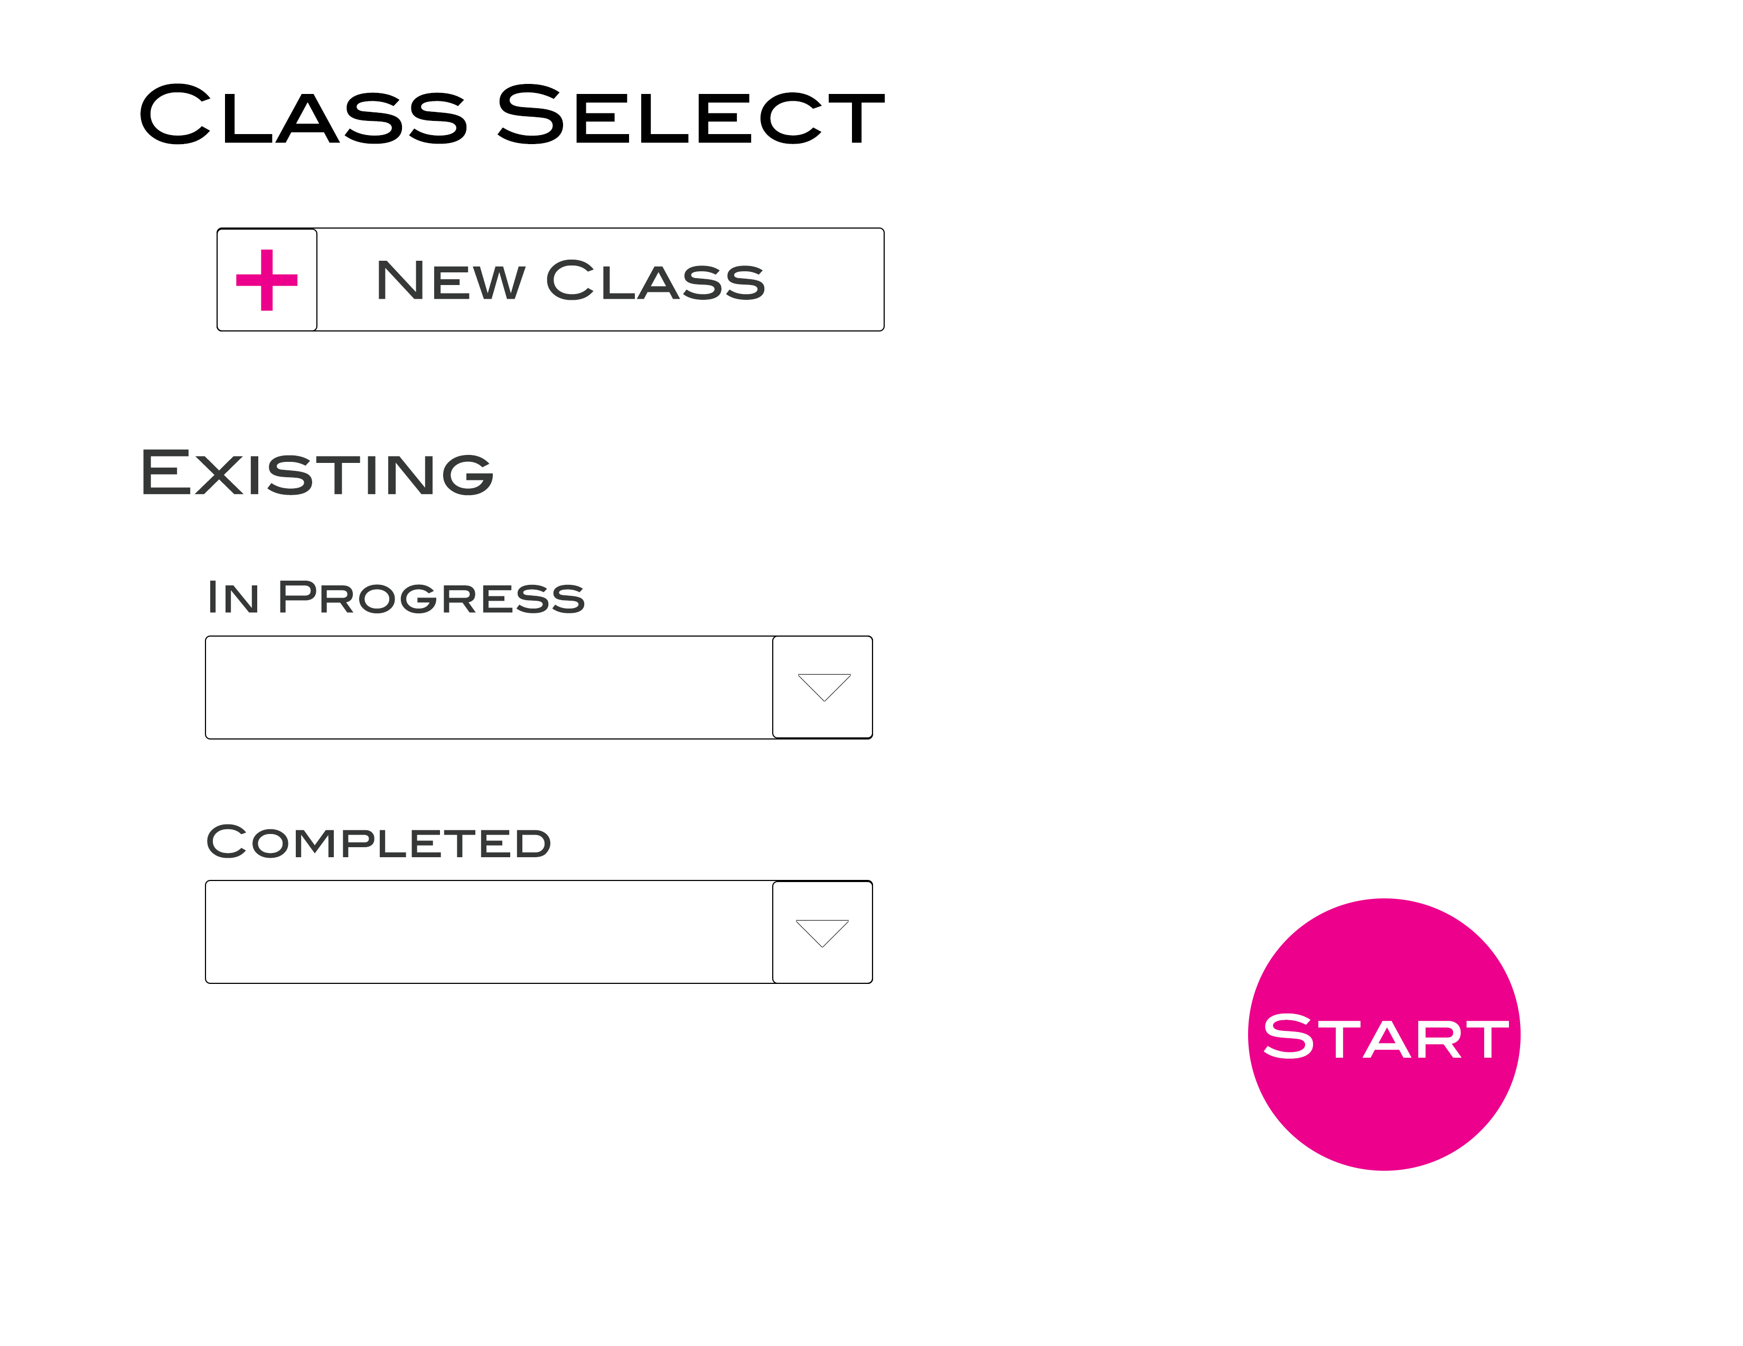
MyDesign
CLICK HERE

Slide 37
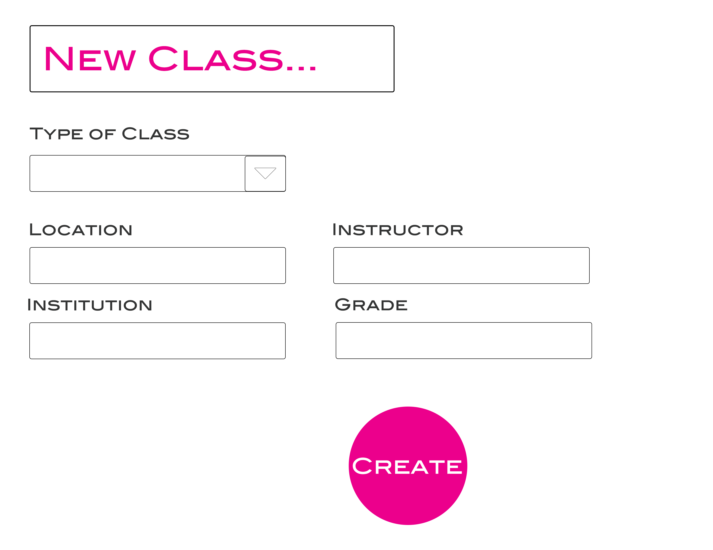
MyDesign
CLICK HERE

Slide 38
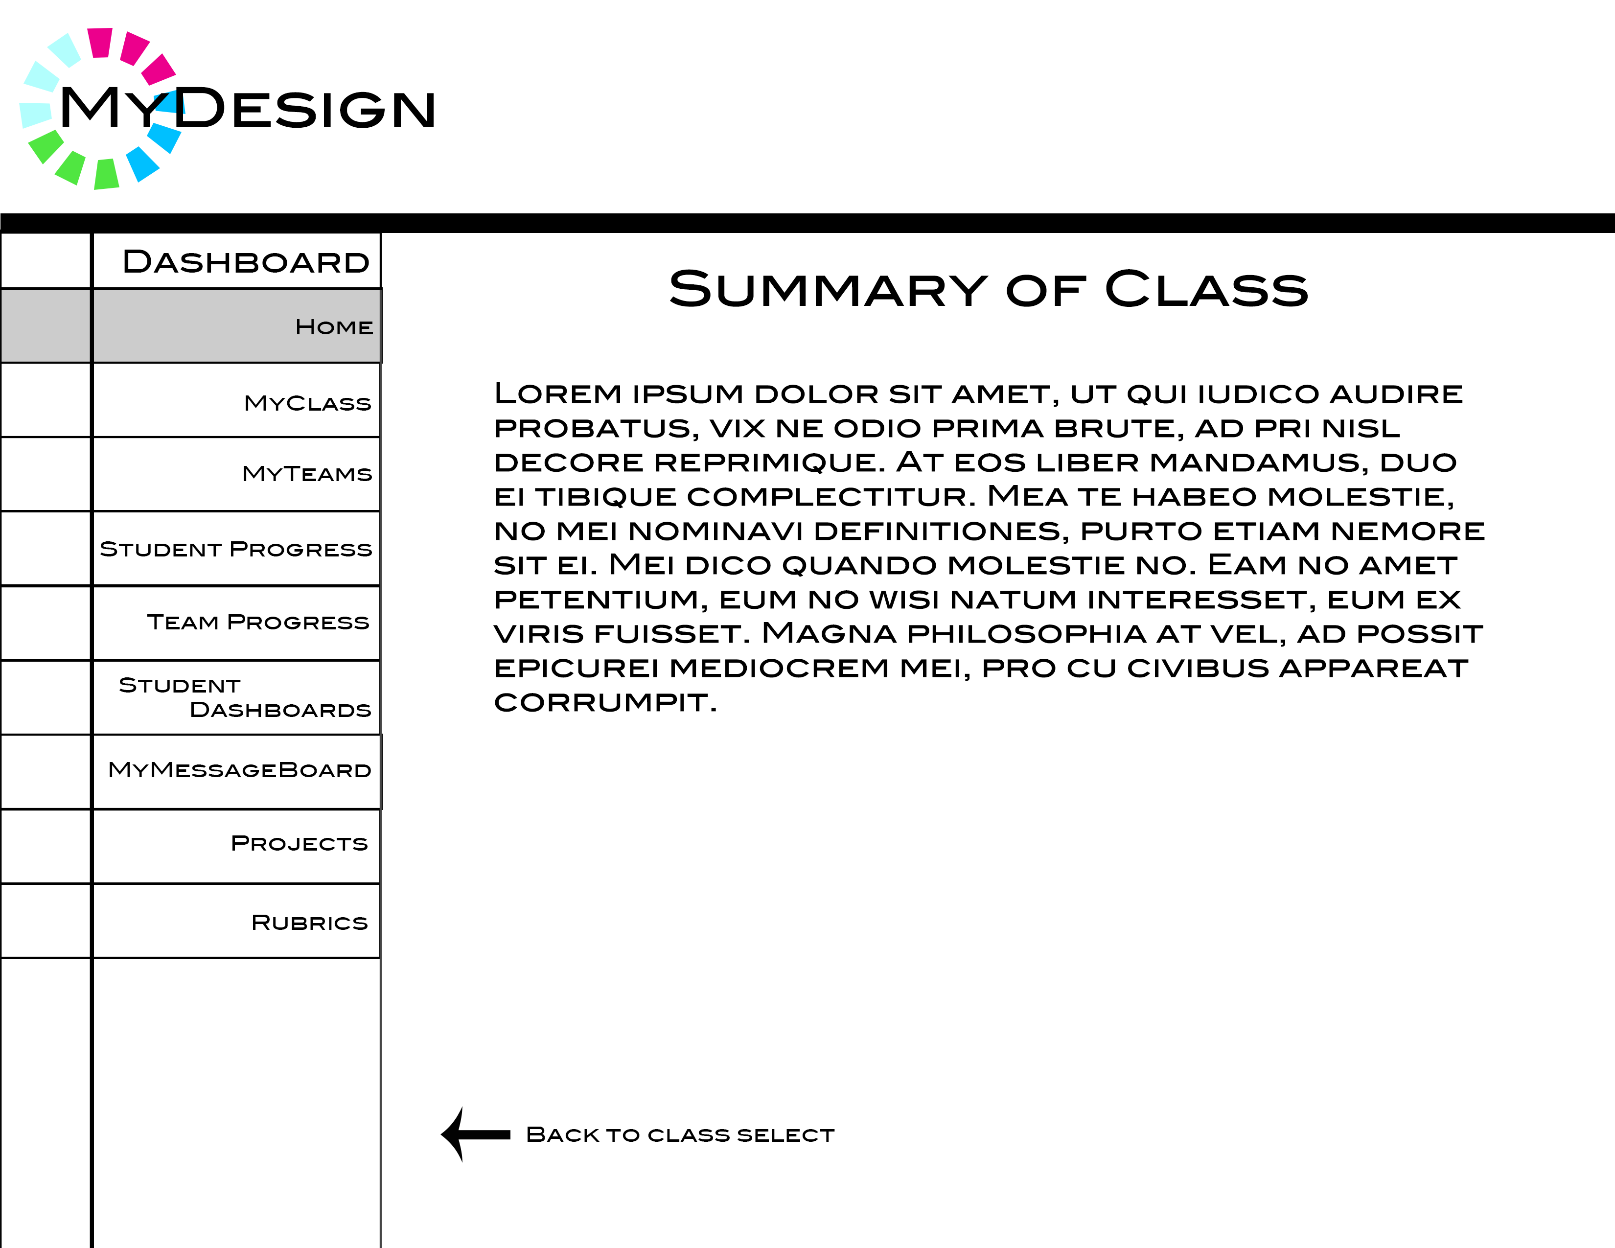
MyDesign
CLICK HERE

Slide 39
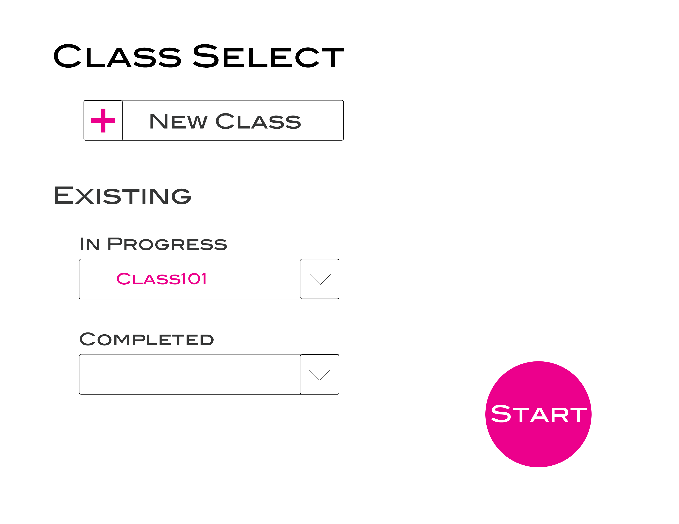
MyDesign
CLICK HERE
Suppose you wanted to choose an existing class?

Slide 40

MyDesign
CLICK HERE

Slide 41
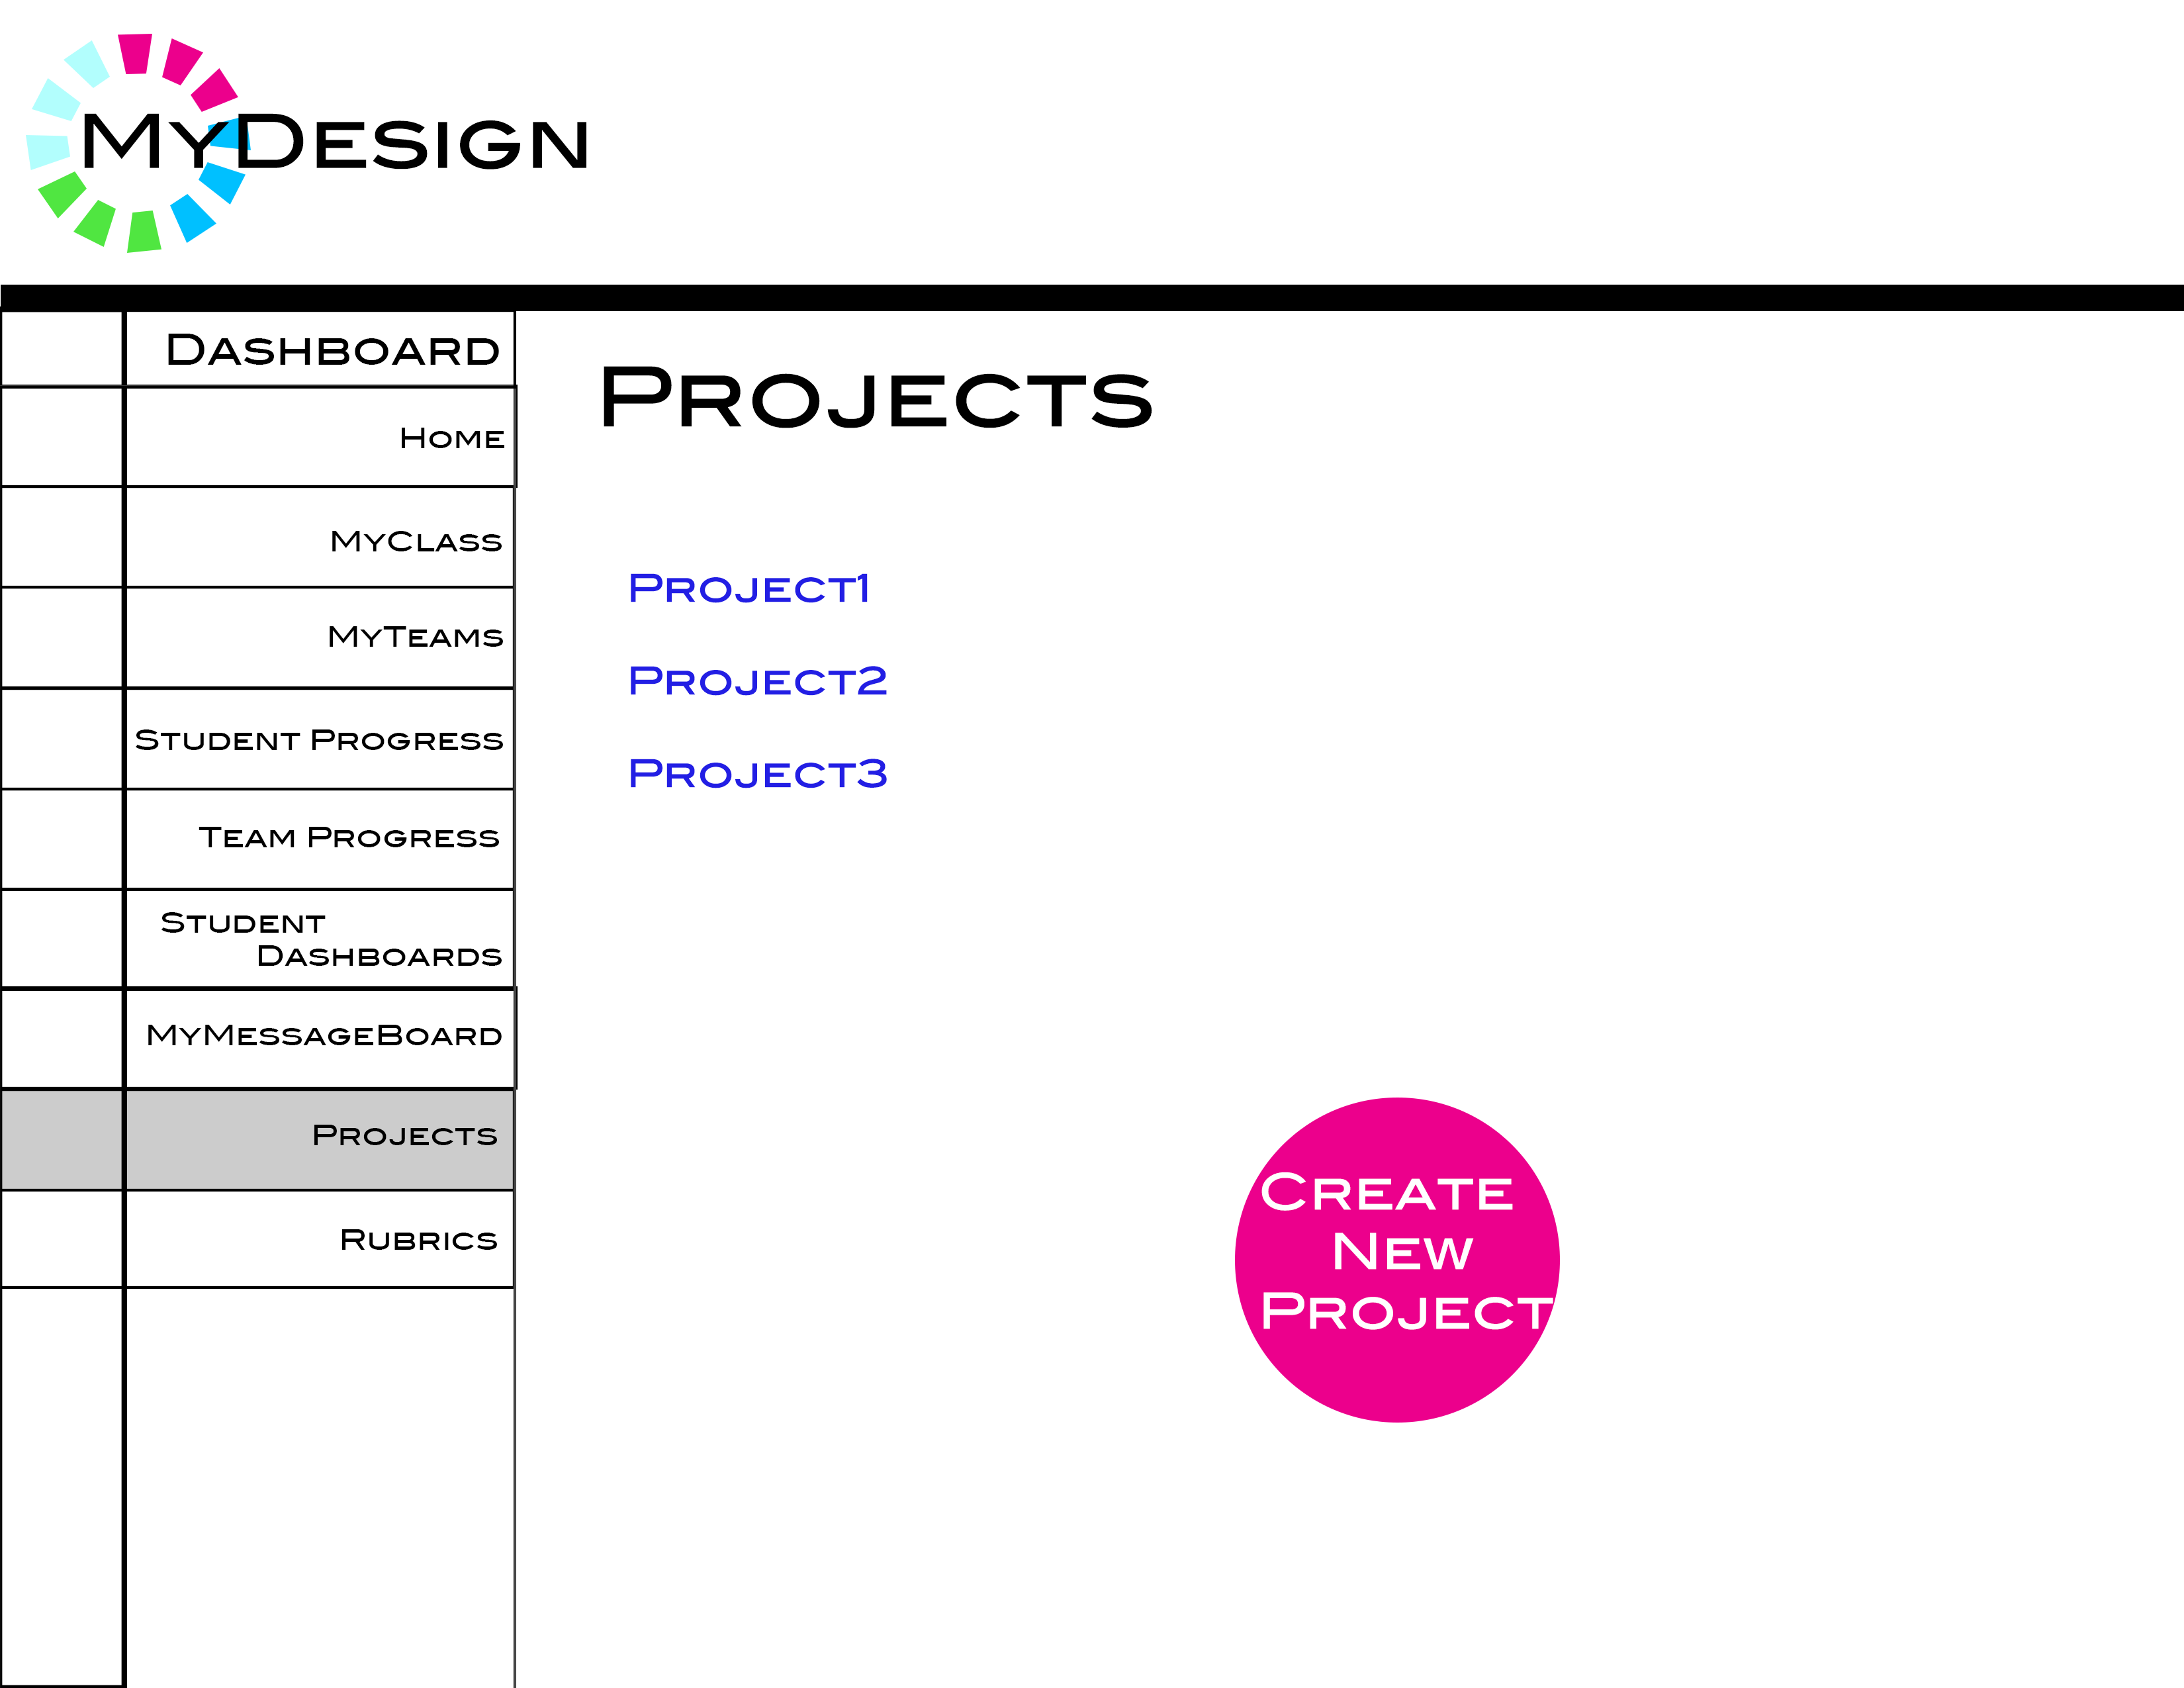
MyDesign
CLICK HERE

Slide 42
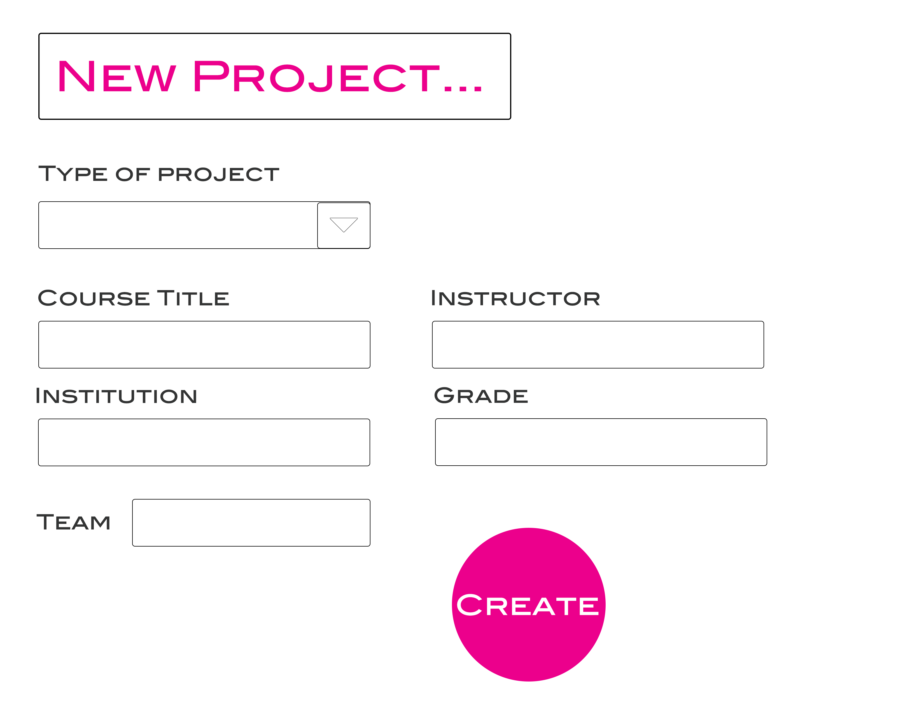
MyDesign
CLICK HERE

Slide 43

MyDesign
CLICK HERE

Slide 44
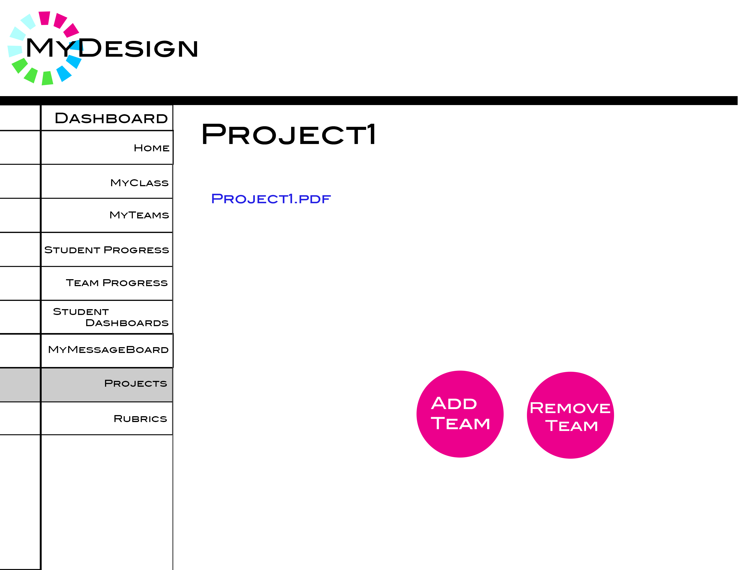
MyDesign
CLICK HERE

Slide 45
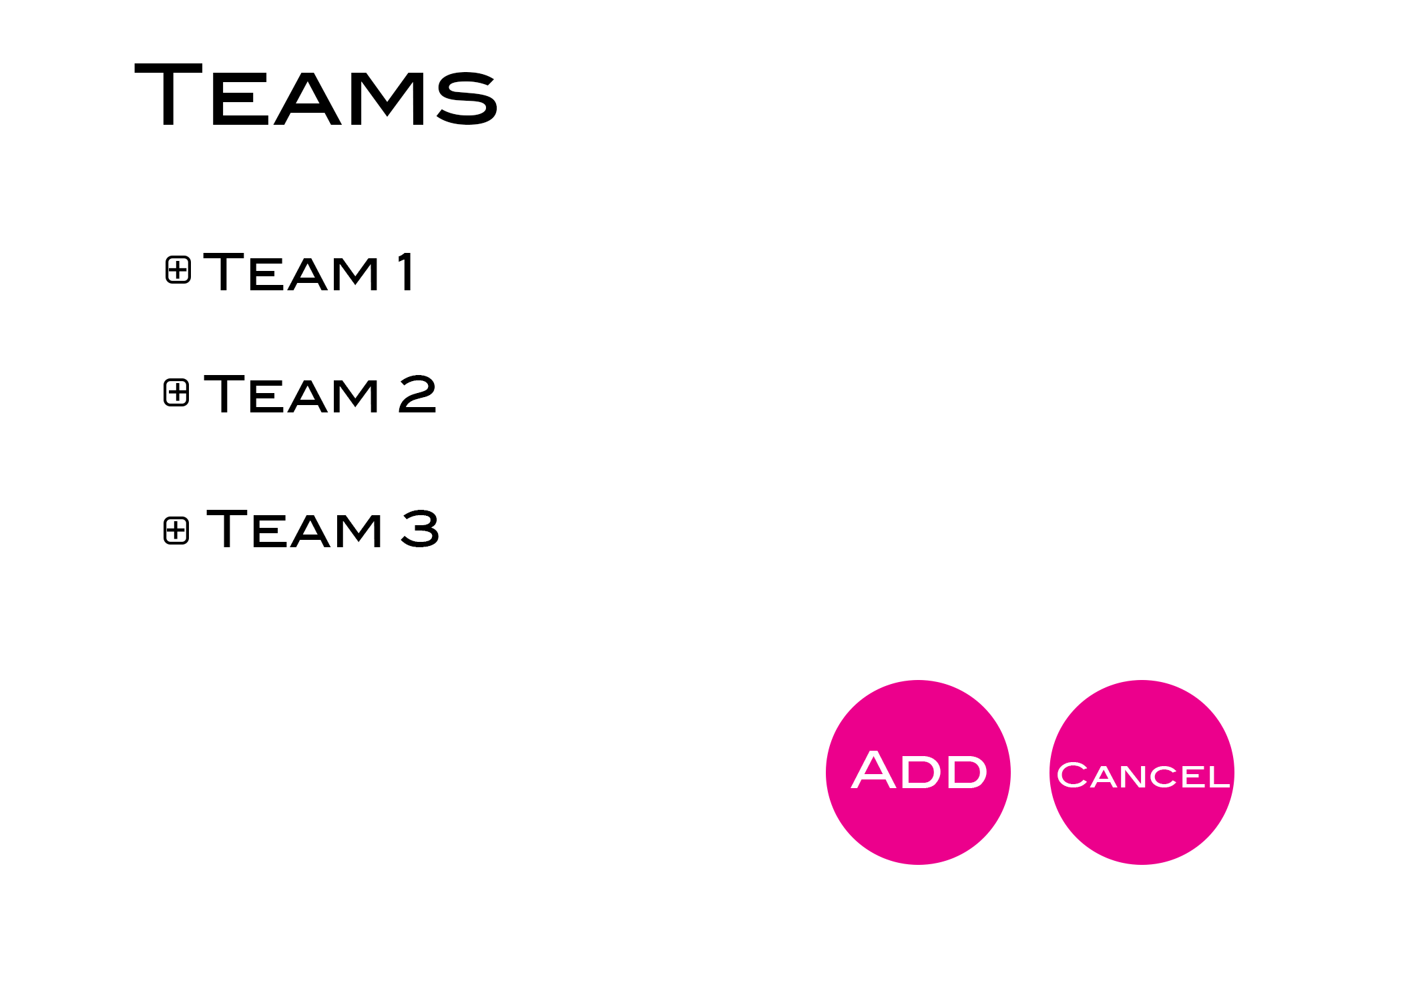
MyDesign
CLICK HERE
CLICK HERE

Slide 46
MyDesign
CLICK HERE

Slide 47
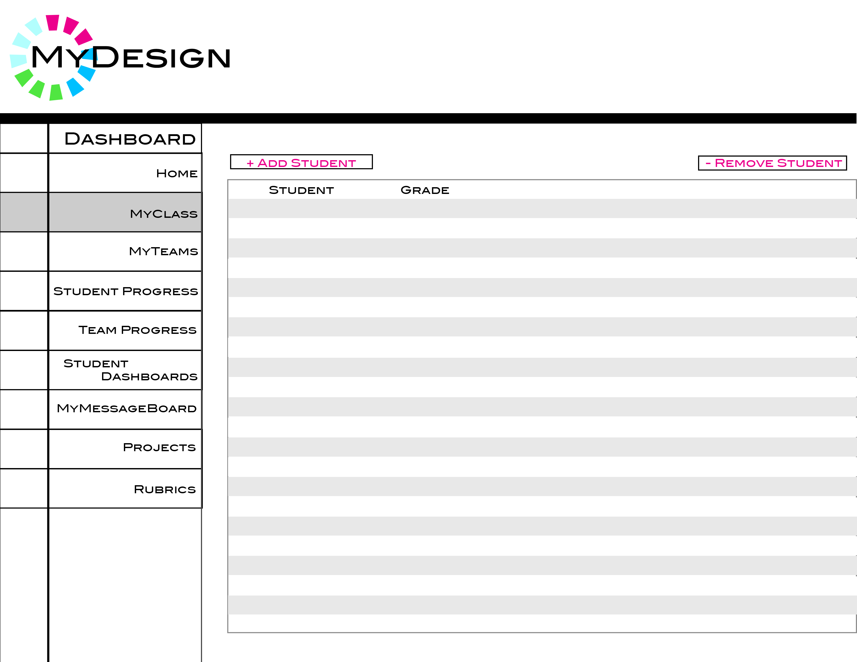
MyDesign
CLICK HERE

Slide 48
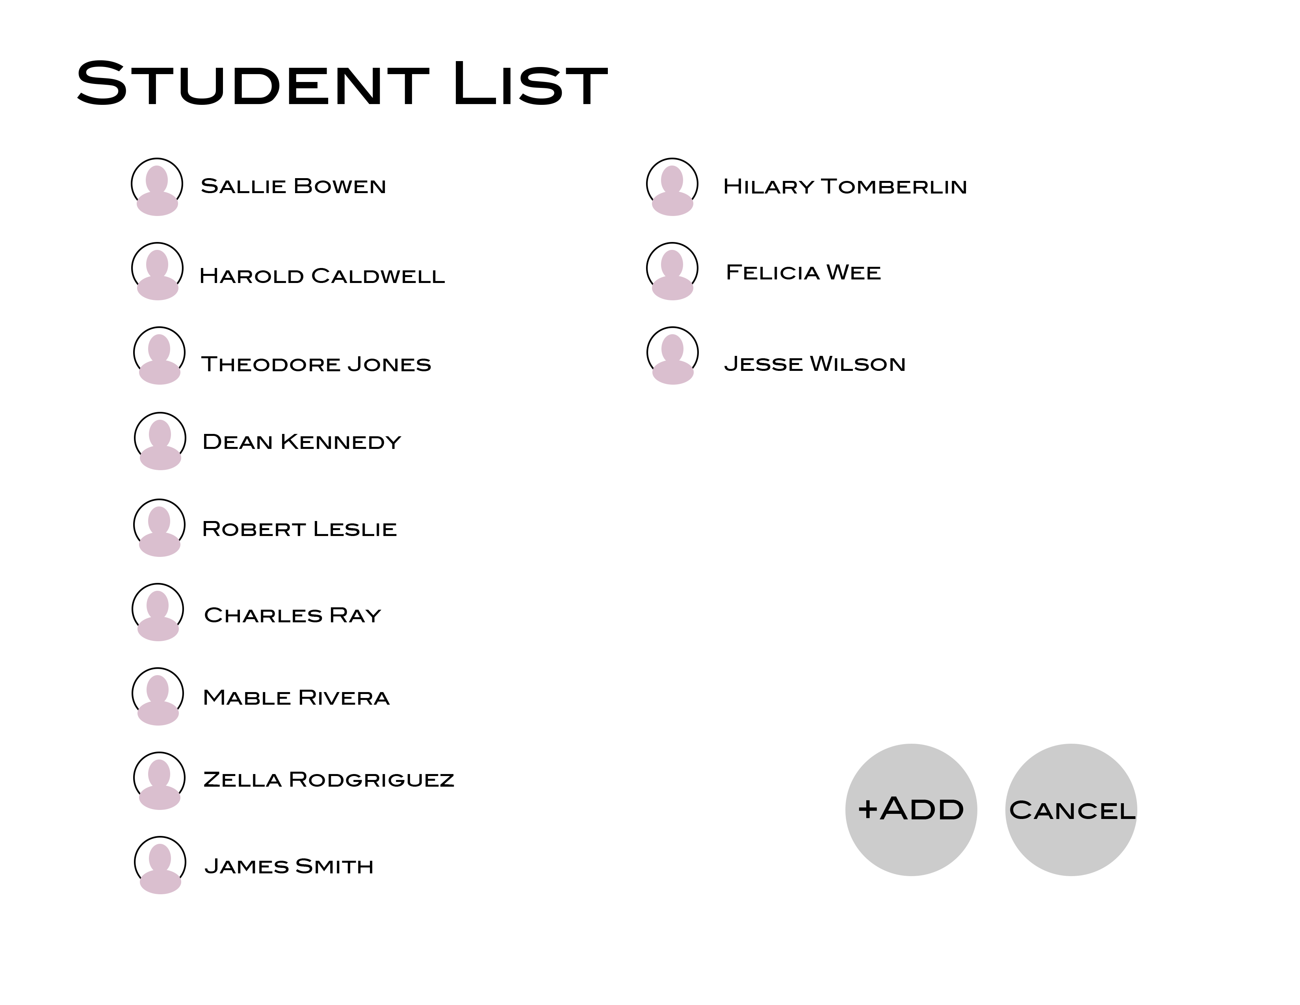
MyDesign
CLICK HERE
+
+
+
+
+
+
+
+
+
+
+
+
CLICK HERE

Slide 49
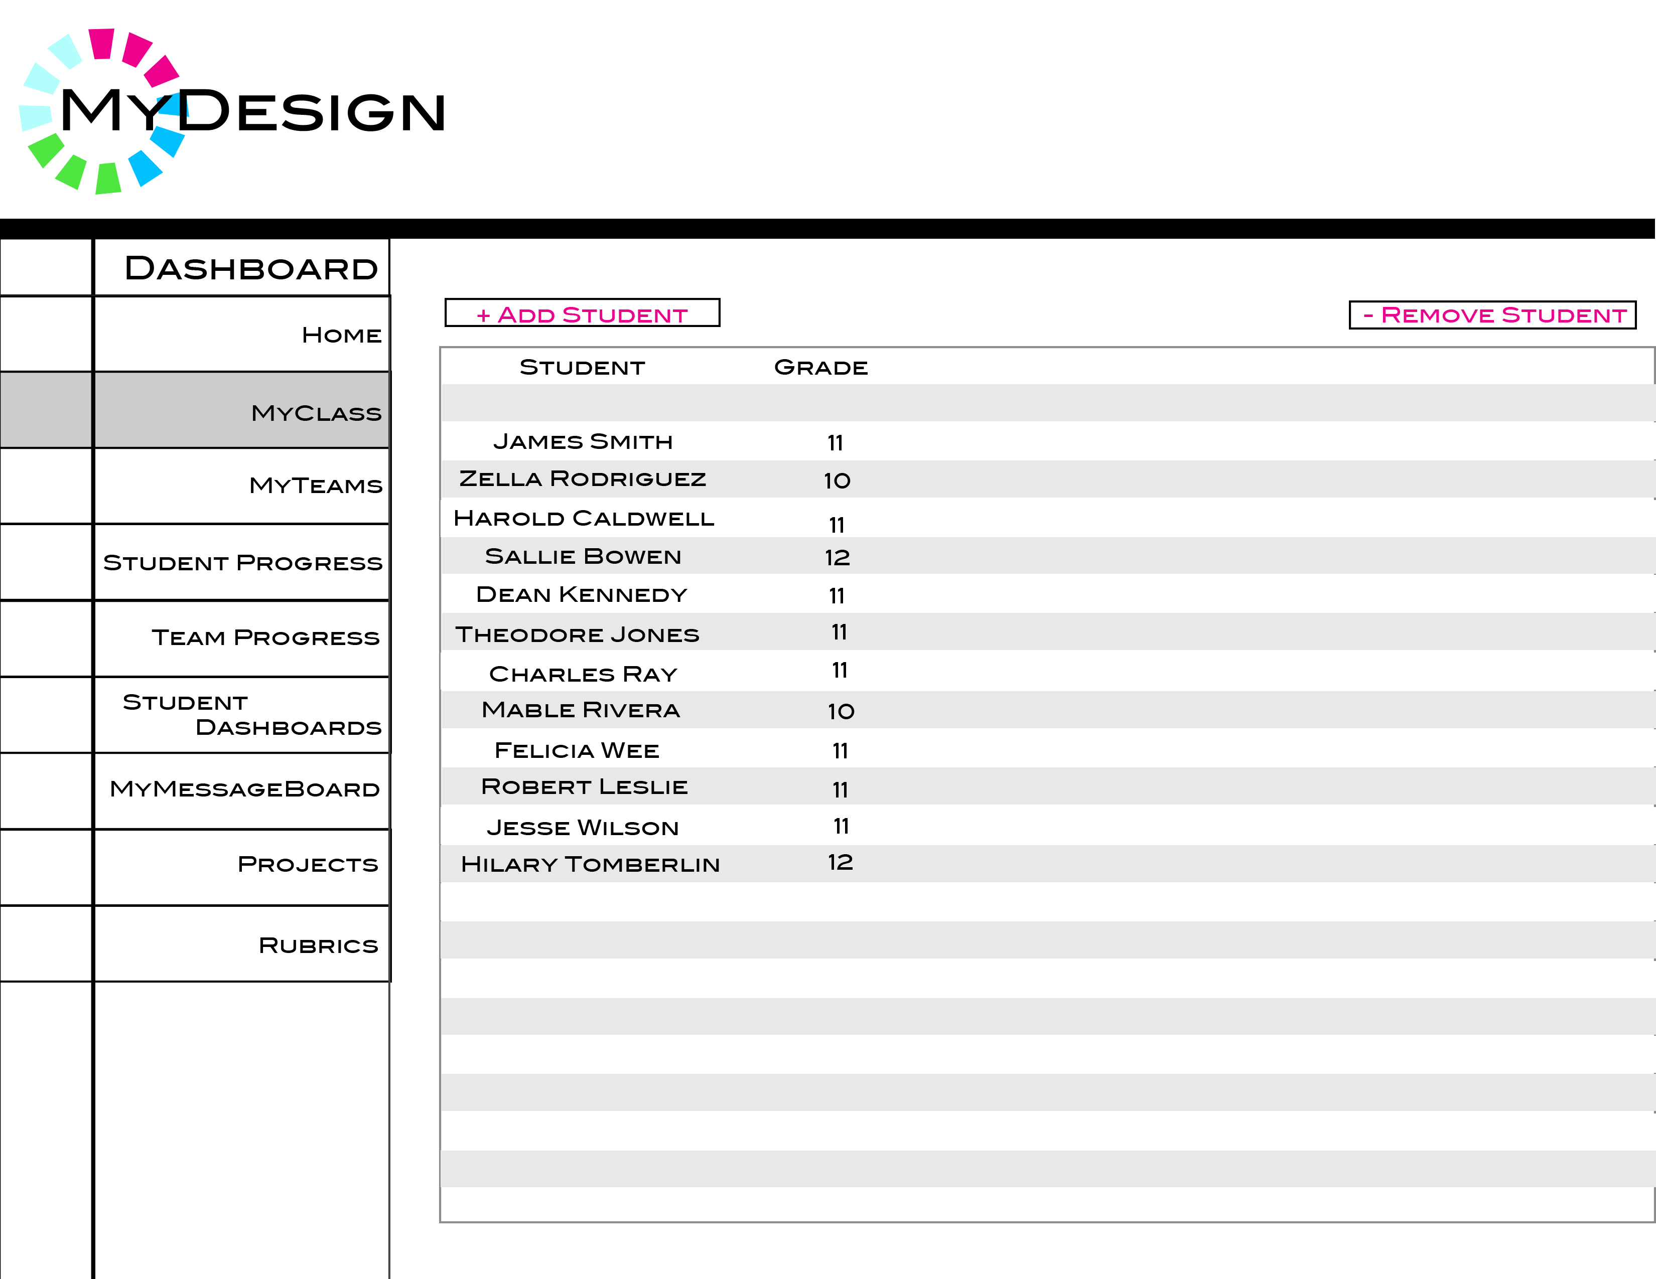
MyDesign
CLICK HERE

Slide 50
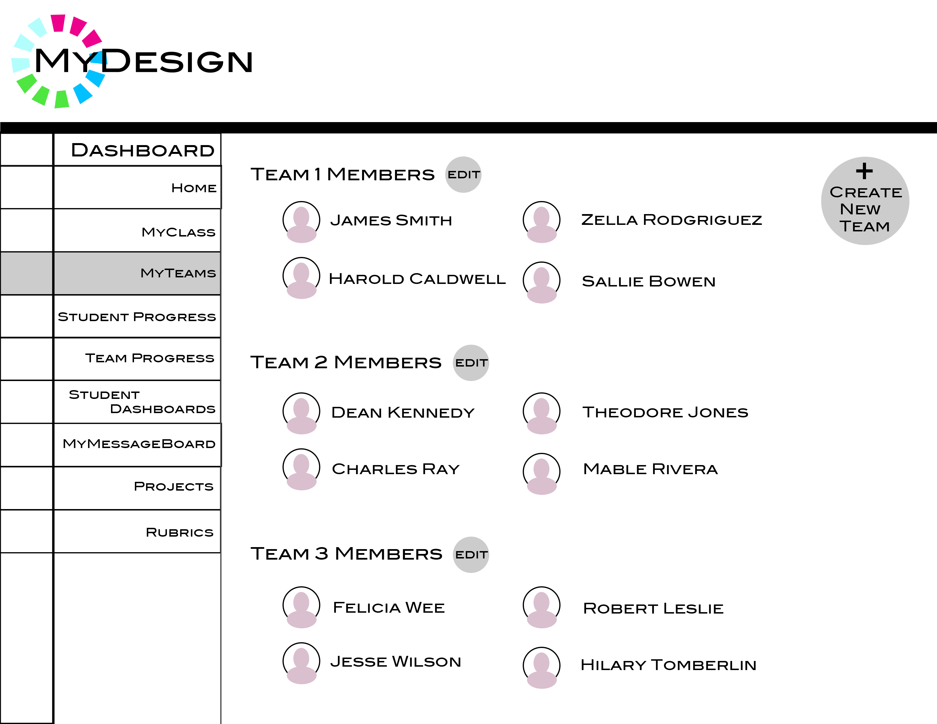
MyDesign
CLICK HERE

Slide 51
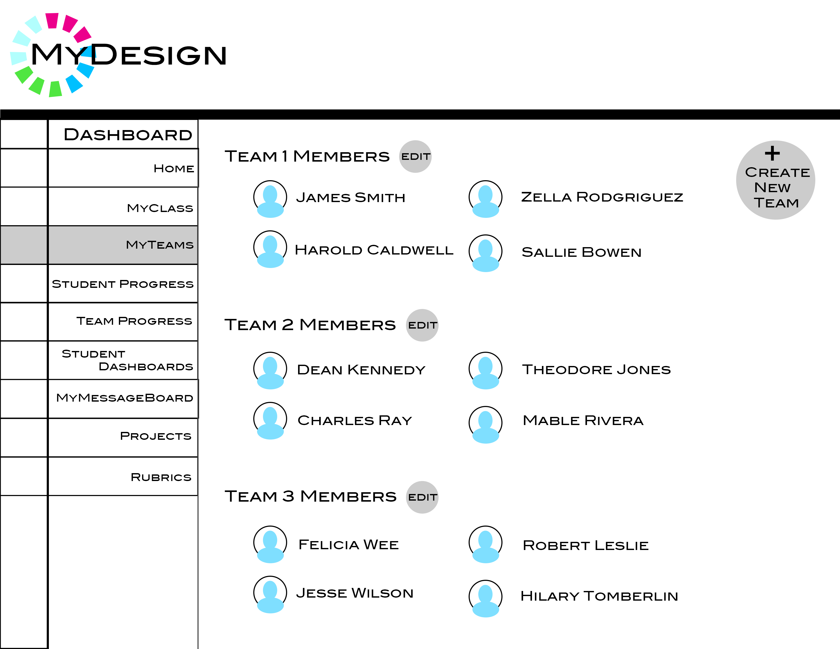
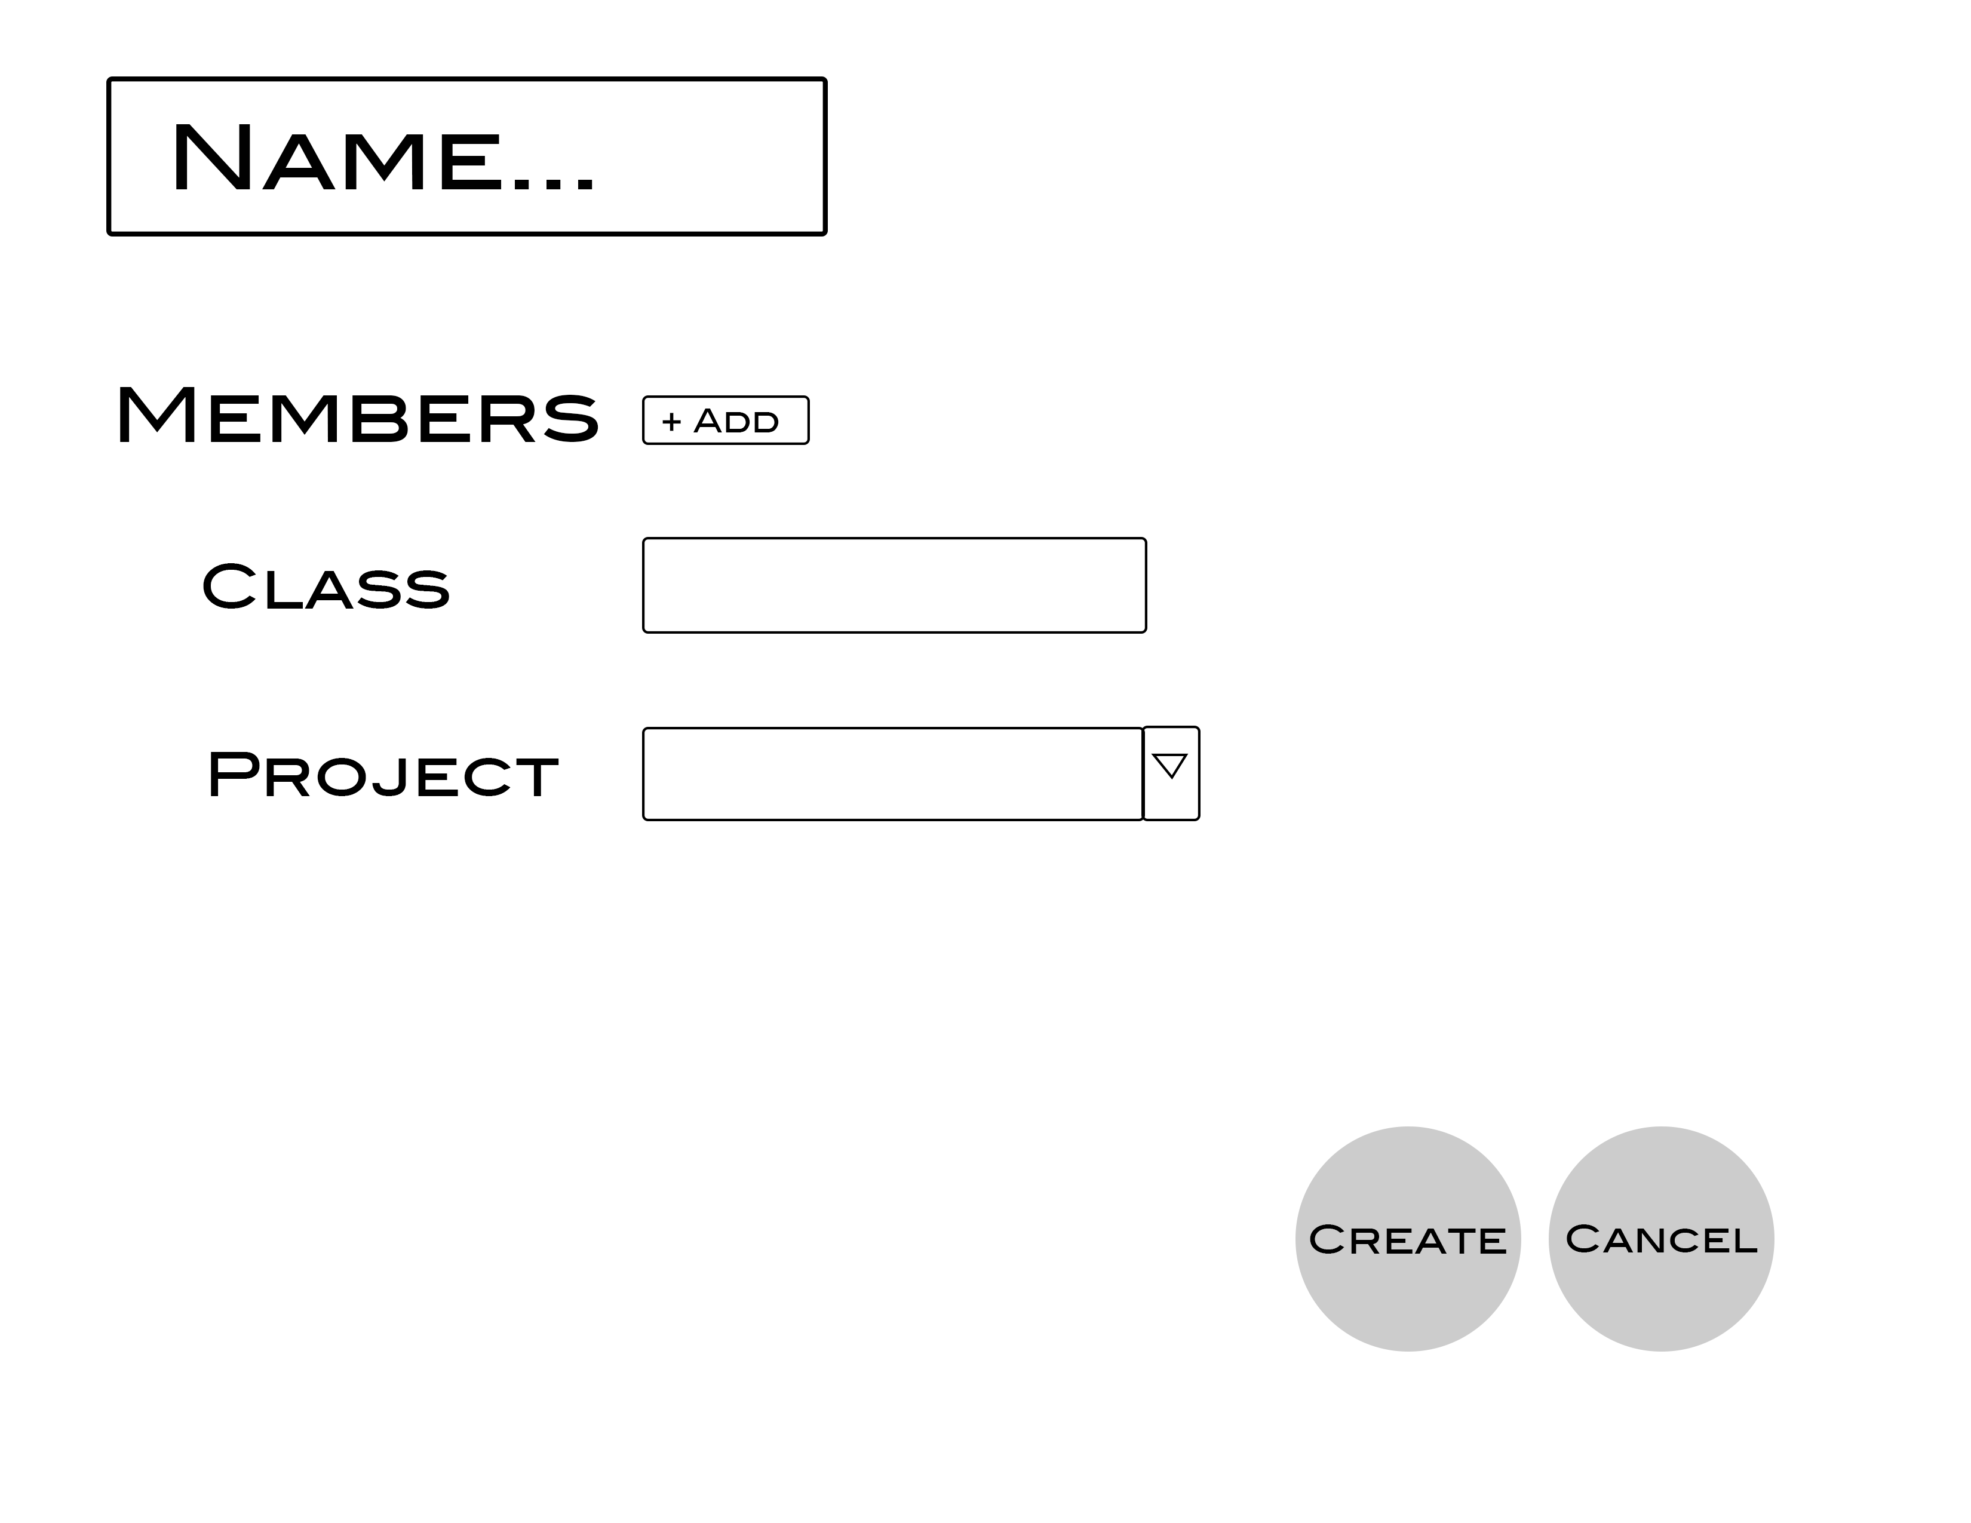
MyDesign
TEAM 3
CLICK HERE

Slide 52
MyDesign
TEAM 3
+
+
CLICK HERE
+
+
CLICK HERE

Slide 53
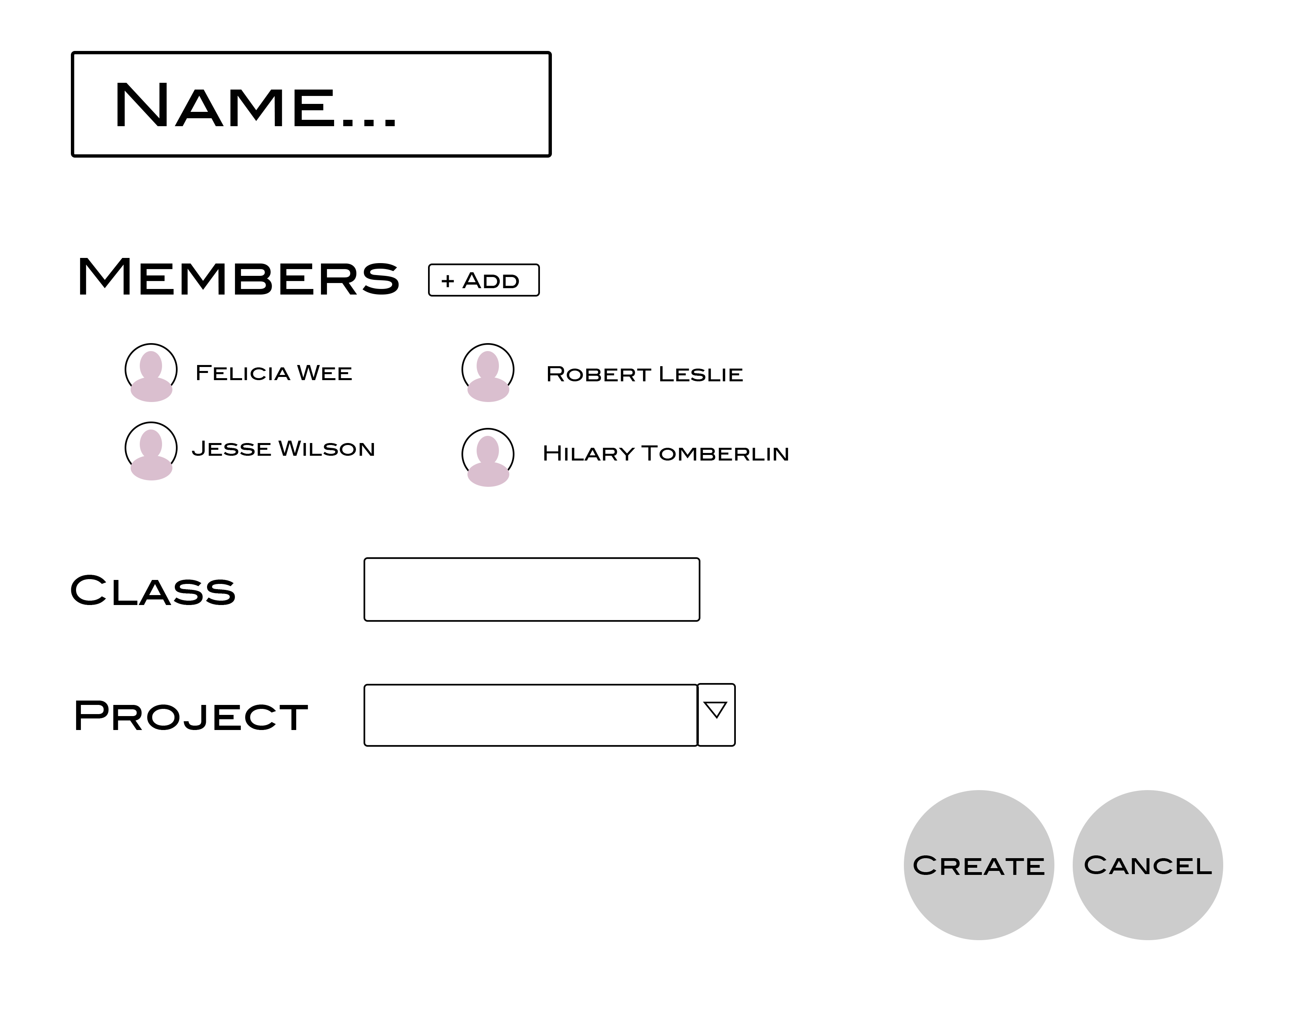
MyDesign
TEAM 3
CLICK HERE

Slide 54
MyDesign
CLICK HERE

Slide 55
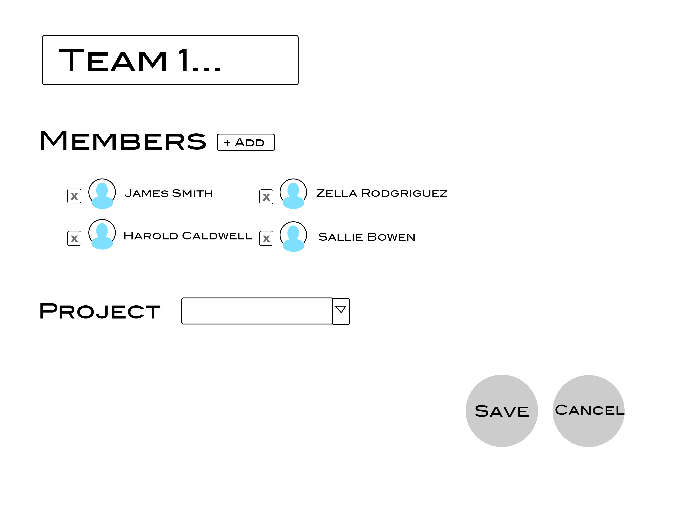
MyDesign
CLICK HERE

Slide 56
MyDesign
CLICK HERE

Slide 57
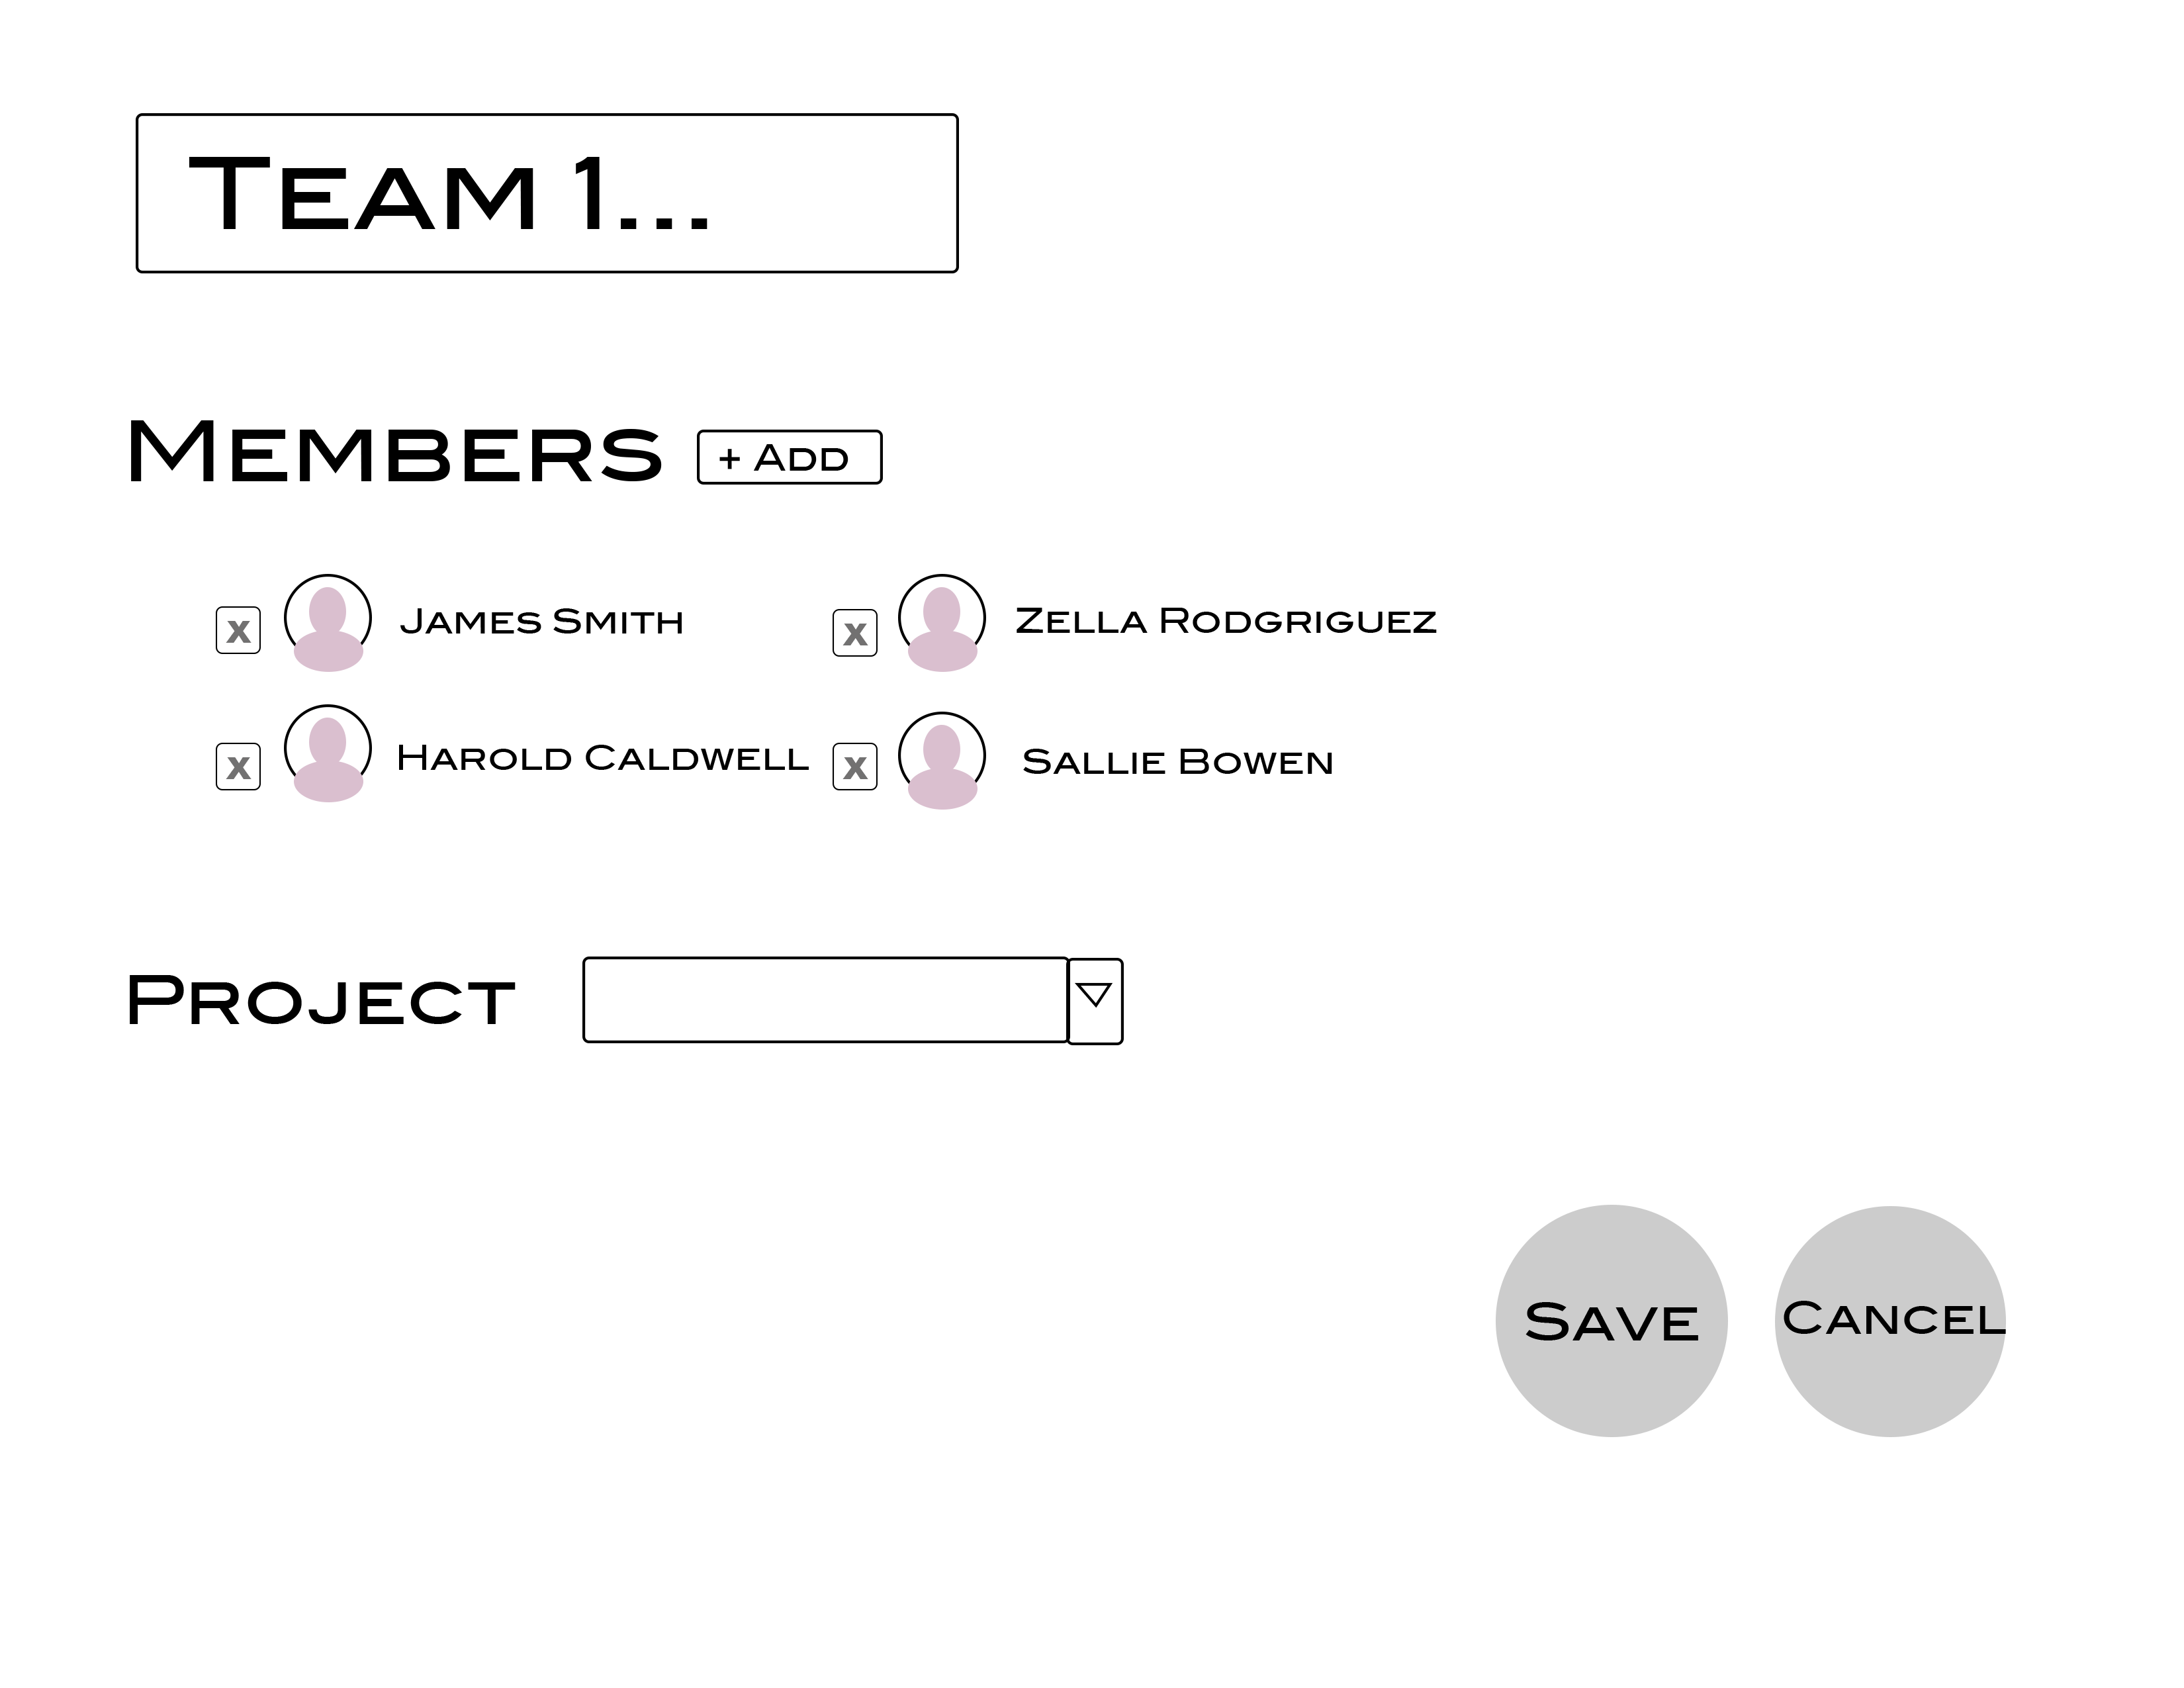
MyDesign
CLICK HERE

Slide 58
MyDesign
CLICK HERE

Slide 59
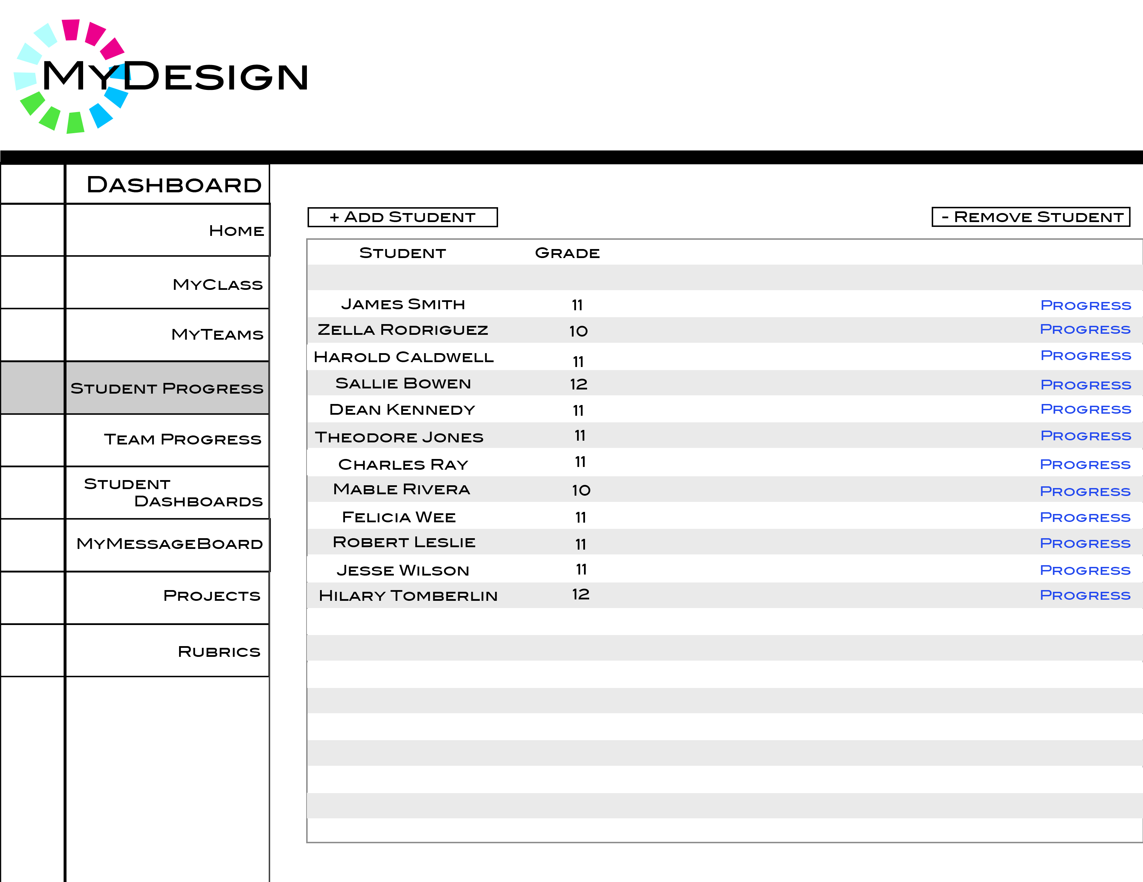
MyDesign
CLICK HERE

Slide 60
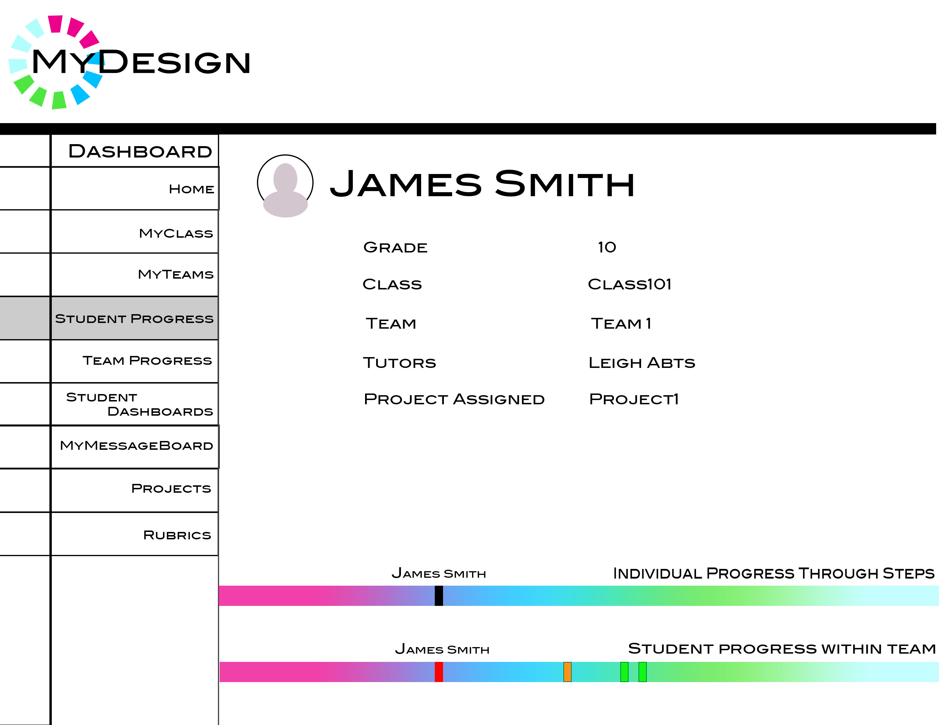
MyDesign
CLICK HERE

Slide 61
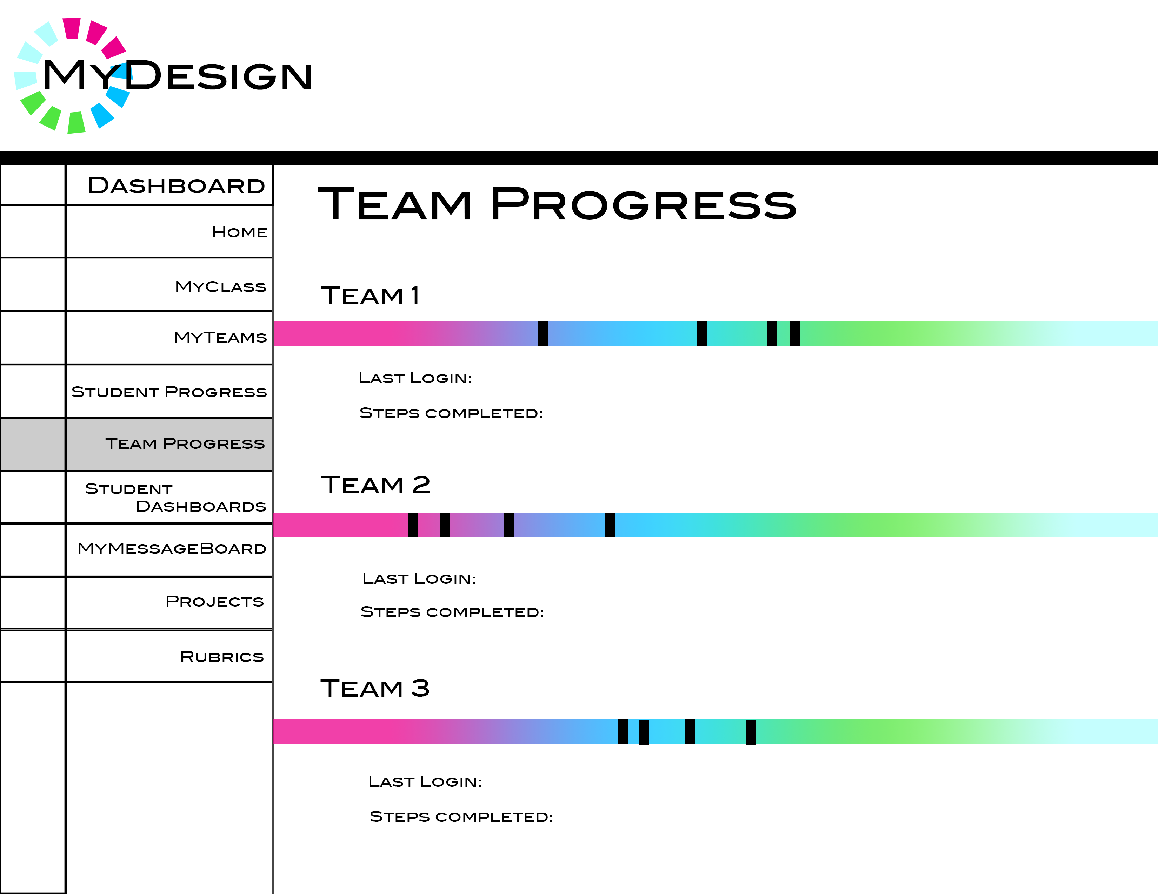
MyDesign

